Slide 1

Lifelong Learning with Bookshare
Professional Development Workshop

Slide 2
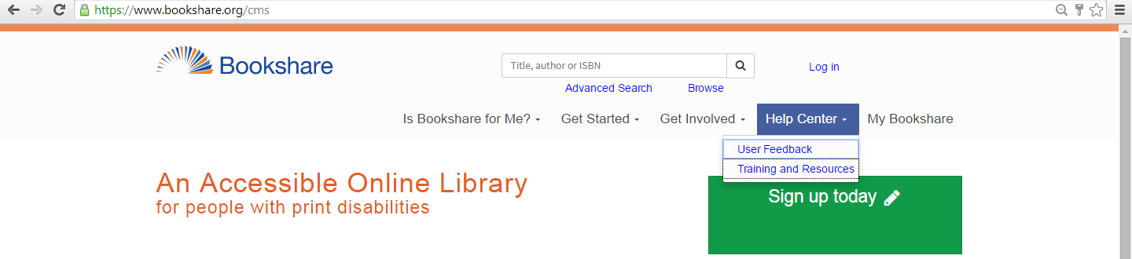

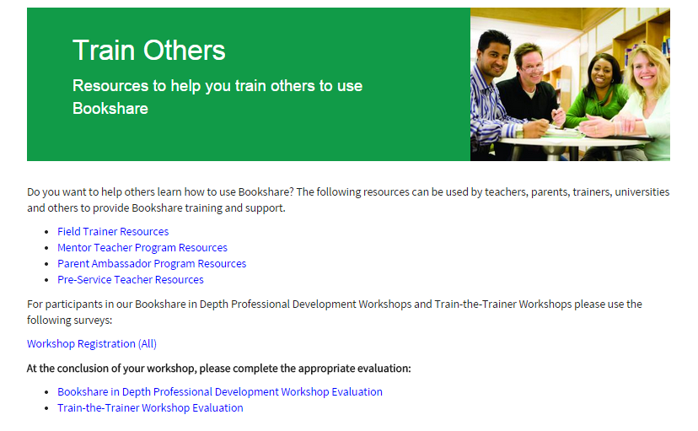
Workshop Registration
Under Help Center, Click on Training and Resources.
Click on Tools for Trainers
Click on Workshop Registration
http://www.surveygizmo.com/s3/1262116/Class-Registration-2013

Slide 3
Welcome and Introductions
What best describes how familiar you are with Bookshare.
  Little familiarity with Bookshare
  Some familiarity with Bookshare
  Strong familiarity with Bookshare
Notes:
Introductions. Name, Role, what hope to get out of the training.

Slide 4
Personal Journaling Opportunity
What are your goals for the training?
What questions do you have?
Notes:
Allow participants to take 1-3 minutes to jot down their goals for the training and questions they have before getting started. Share out some examples

Slide 5
Workshop Outcomes
Understand Bookshare and its eligibility criteria and membership options
Use the Bookshare online tools to manage your account and reading lists
Search and request books from the Bookshare online library
Download digitally accessible materials and find the right tools for your students
Prepare students for transition
Bookshare is a project of Benetech - www.benetech.org
Benetech’s nonprofit motto: Technology Serving Humanity
Notes:
5
This workshop was designed to educate participants on how to use Bookshare resources and tools so that teachers can provide timely access to textbooks and print materials in accessible formats for students with print disabilities.
Reference agenda handout. Today, we’ll spend the next 5-6 hours covering in detail, the following topics. We’ll also spend time logging into Bookshare so that you can experience first-hand, the available books, tools, and services that Bookshare offers.
NOTE TO TEAM: I’m sure there are more, but I tried to distill the long list from the Bookshare website into the main objectives of the day. Let me know what I’m missing.

Slide 6
Four Part Training Modules
What is Bookshare and how to get your students access?
How to find the books your students need?
How to find the right tools for your students?
How to support students transitioning to other schools or college and career?

Slide 7
Module 1:
What is Bookshare and how to get your students access?

Slide 8
What is Bookshare

Slide 9
What are Accessible Educational
Materials (AEM)?
AEM are specialized formats of core instructional materials that can be used by and with students with print disabilities.
IDEA 2004 requires that all students with disabilities who need AEM should be provided with the instructional materials they need, in formats they need, at the time materials are needed. Some additional students served under Chapter 15 of the Rehabilitation Act of 1973 may also qualify as persons with print disabilities and need AEM.
Bookshare is an example of AEM.
Important: Just because a student has an IEP or 504, does not mean they are eligible for Bookshare.
Notes:
AEM are specialized formats of core instructional materials that can be used by and with students with print disabilities.
IDEA 2004 requires that all students with disabilities who need AEM should be provided with the instructional materials they need, in formats they need, at the time materials are needed
In addition some protected handicapped students served under Chapter 15 of the Rehabilitation Act of 1973 may also qualify as persons with print disabilities and need AEM.
Important: Just because a student has an IEP or 504, does not mean they are eligible for Bookshare.
Specialized formats enable students with print disabilities to gain access to curricular content, master IEP goals, and achieve academic standards. Accessible educational materials provide students with the same curricular content as print-based text. The use of specialized formats is an accommodation for access to curricular content.

Slide 10
What is Bookshare®?
Online library of accessible educational materials for readers with print disabilities
12-year initiative of Benetech
  More than 335,000 Student Members
  More than 15,000 schools and other
  organizations
  More than 315,000 titles
  More than 1,000 new books added every month
Notes:
10
Talking Points
Bookshare is an online library of accessible materails for readers with print disabilities.
For sighted people, technology makes access to information easier; for people who are blind, it makes access possible.
Bookshare is an initiative of Benetech, a nonprofit organization that grew out of Jim Fruchterman's early work with reading machines for the blind (Arkenstone). The sale of Arkenstone led to the creation of Benetech and its first project, Bookshare, focuses on the challenge of access to reading materials for people with print disabilities.
For a decade, Bookshare has been bringing reading to life for people with print disabilities and currently has...(use data from slide; as of February 2012)

Slide 11
Bookshare’s Mission
Bookshare's goal is to raise the floor of access so that people with print disabilities can obtain a broad spectrum of print materials at the same time as everyone else.
Bookshare provides a large quantity of books and newspapers in accessible formats and in a timely manner
Bookshare’s vision encompasses new technological developments as well as new applications of widely available technologies to stretch the power of technology for increased access to content.
Notes:
People with print disabilities deserve to enjoy reading as much as all other readers. Yet, currently fewer than five percent of the books needed by people with print disabilities are available in accessible formats such as digital text or digital Braille.
Bookshare®'s goal is to raise the floor of access so that people with print disabilities can obtain a broad spectrum of print materials at the same time as everyone else.
People with visual impairments, physical disabilities and/or learning disabilities can look to Bookshare to dramatically increase the quantity and timely availability of books and newspapers in accessible formats. Further, Bookshare’s vision encompasses new technological developments as well as new applications of widely available technologies to stretch the power of technology for increased access to content.

Slide 12

What Bookshare Offers
Digital books for individuals with print disabilities
24/7 access to books
FREE memberships for qualified U.S. students through OSEP award.
  Students include anyone participating in a course with coursework for over 30 days
FREE assistive technology software for members
Notes:
12
Bookshare believes that people with print disabilities should have the same ease of access to books and periodicals that people without disabilities enjoy.
Digital Books
130,000 title and growing every day
Free memberships
Bookshare operates under an exception to U.S. copyright law which allows copyrighted digital books to be made available to people with qualifying disabilities. We’ll talk about this a little more in a few minutes.
Free assistive technology
Read Out Loud
Victor Reader
27/7 access to books
Two membership options
Let’s go into a little more depth in each of these four areas.

Slide 13


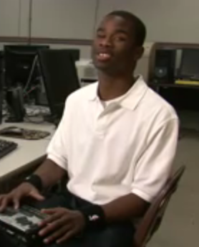
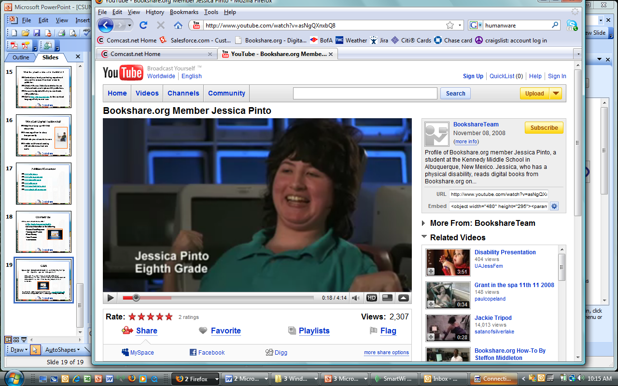
How Does Bookshare Help?
Access to AEM in a timely manner
Equalize educational opportunities
Help students with print disabilities keep up with classmates
Encourage them to read and study independently
Reduce costs of support for students with special needs
Notes:
13
Member Images:
Top left: Alex from New York (orange shirt)
Top right: Ashley from Michigan (cap/gown)
Lower left: Steffon from Alabama (white shirt)
Lower right: Jessica from New Mexico (green blouse)
People with Visual Impairments
Members with visual impairments can listen to books with using a text-to-speech synthesized voice, read books in Braille, or access the material in large print. Hard copy Braille books can also be ordered-these are then created by a partner organization that specializes in producing embossed Braille books. Members with low vision can read books in an enlarged font using either a screen magnifier or by opening the book in a software program that supports increased font size, color, contrast, etc.
People with Physical Disabilities
Members can read books on a computer or a variety of portable devices, either visually and with text-to-speech as desired. Bookshare books are as easy or easier to access than books on tape and may be controlled with an individual's single-switch or other adaptive technology.
People with Learning Disabilities
Members with severe dyslexia typically benefit from access to the full text of books in digital format, for multi-modal reading with both visual and audio (through synthetic text to speech). Many great software programs exist that provide a range of reading support specifically designed for individuals with learning disabilities, including highlighting of text as it is read aloud, changing margin, word, paragraph and line spacing, and setting custom background and print colors.

Slide 14
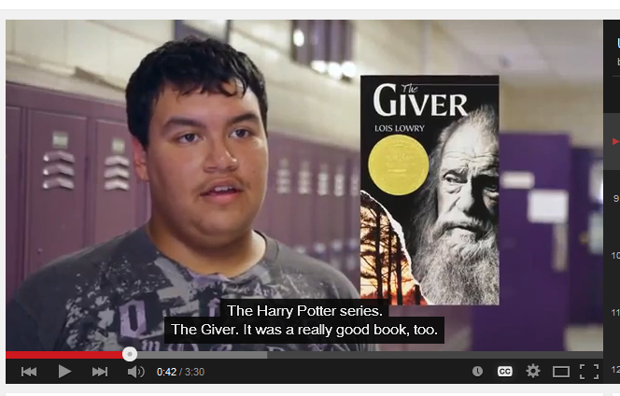
How Can Bookshare Help Students?
https://www.youtube.com/watch?v=pqMyXvjAapg&list=UUsdaGZ6BwljeFXCyz694hkQ
Notes:
Let’s take a look! https://www.youtube.com/watch?v=pqMyXvjAapg&list=UUsdaGZ6BwljeFXCyz694hkQ

Slide 15
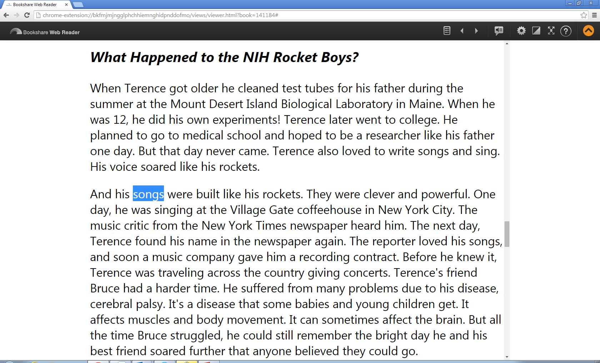
Ways to Read using Bookshare
  Multi-modal reading: See and hear words simultaneously
  View books with large font on a PC screen, or print
  Listen to them (many voice options)
  Read Braille (digital or hardcopy)
Notes:
15
You may have used an assistive reading tool such as Read:OutLoud Bookshare edition, Web Reader, Read2Go, or Go Read to read a book, using multi-modal reading where text and audio are synchronized.
Students can also read Bookshare books in three other ways (view, listen, and braille).

Slide 16
Available Bookshare Formats
Bookshare offers text-based access for NON-copyrighted books to anyone
Bookshare formats available to individuals with qualifying print disabilities (copyrighted materials)
  DAISY-3 (Digital Accessible Information System)
    global digital talking book format
  MP3 and Daisy Audio
    digital audio
  BRF (Braille Ready Format)
    digital braille
Notes:
Bookshare is one source of accessible instructional materials for students with print disabilities. It provides three specialized formats of copyrighted print materials (BRF, DAISY 3 text, and MP3) and two other formats for freely-distributed materials (HTML and TXT).
Information from AIM slides that might be used in this section:
Accessible educational materials (AEM) are specialized formats of core instructional materials that can be used by and with students with print disabilities. IDEA 2004 describes four kinds of specialized formats: braille, audio, enlarged print and electronic text.
Background information for trainers:
Braille is defined by the American Foundation for the Blind (AFB) as "a series of raised dots that can be read with the fingers by people who are blind or whose eyesight is not sufficient for reading printed material… Braille is not a language. Rather, it is a code by which languages… may be written and read”. Braille materials provide the same content as standard print. They can be embossed on specialized paper and digital braille can be made available through refreshable displays.
Audio is a format that allows students to access printed material by listening to CDs, MP3 files, text-to-speech programs, and other auditory alternatives to printed texts.
Enlarged print is defined by the American Printing House for the Blind (APH) as “print for text passages that is larger than the print used by that segment of the population with normal vision.” Enlarged print format provides the same content as standard print, but the print is larger. In addition, the printed page may appear in simpler font type and the page sizes may be larger to enable those with visual impairments to read more easily.
Digital text (also known as electronic text or E-text) files include file formats produced by word processing or text editing programs, such as Microsoft Word formats, Rich Text Format (RTF), American Standard Code for Information Interchange (ASCII), Hypertext Markup Language (HTML), and Digital Talking Books (DTB – Text-based DAISY format). These files can be transformed into accessible forms that provide font size and color options, text-to-speech capability, and other text enhancement features.
Specialized formats enable students with print disabilities to gain access to curricular content, master IEP goals, and achieve academic standards. Accessible instructional materials provide students with the same curricular content as print-based text. The use of specialized formats is an accommodation for access to curricular content.
AEM and Access to the Curriculum
Provides meaningful and equal access to curricular content
Lessens barriers posed by traditional texts
Facilitates access to learning
Promotes accessible curriculum
What are the responsibilities of schools to provide AIM?
IDEA 2004 requires that all students with disabilities who need AIM should be provided with the instructional materials they need, in the formats they need, at the time the materials are needed. In addition, some protected handicapped students served under Chapter 15 of the Rehabilitation Act of 1973 may qualify as persons with print disabilities.
However, it is important to note that the definition of SWD within IDEA does not match that of the definition in copyright law. Therefore, just because a student has an IEP or 504, does not mean they are eligible for Bookshare. The next slide details the eligibility requirements.

Slide 17
Bookshare Format Options:
DAISY
Digital Accessible Information System
  Standard for producing and reading accessible and navigable multimedia publications
Bookshare produces DAISY digital text
  With images (larger file)
  Without images
Notes:
DAISY is the acronym for Digital Accessible Information System. A DAISY book is the multimedia equivalent of a print publication. DAISY formats allow multiple modes of access. DAISY usually refers to Digital Talking Books, digital text (electronic) books, or a combination of synchronized audio and digital text (electronic) books. A DAISY book is designed to be easily navigated, so the reader can move around the text efficiently and flexibly.
Bookshare produces DAISY 3 text format (text and no audio) and MP3 format. The DAISY 3 text format is a DTB containing a Navigation Center and marked up/structured electronic text only. No audio is present. This file may be used for the production of braille. It uses XML markup, which allows a DTB producer the ability to structure a book in detail.
Bookshare offers two types of DAISY-text files: one without images and one with images. Members can choose whether or not they want the books with images. The image file is much larger than the text file. Bookshare is also incorporating image descriptions. Levels of structure: Chapter, Section, Page, Paragraph, Word.
Downloading books:
Bookshare uses standard Zip compression technology, so files download as “zipped” files. The zip compression creates just one file per book, which means Bookshare books are much easier to manage and take up less disk space on your computer. Windows XP and above have Zip capability built into the operating system.
Once delivered to the user's PC, the electronic text in the DAISY text file can be spoken to the user using synthetic speech: a computer-generated voice that speaks the text aloud. This can be done by specialized software that knows how to speak the text. There is a range of different voice synthesizers available, each with its own voice characteristics. DAISY players also enable navigation by keyboard commands and text-to-speech.
Digital text can be synchronized visually with audio, for simultaneous reading and hearing a word read out loud using one of the many very high quality voices. The text in Bookshare DAISY files can also be enlarged for people with low vision, as well as being supported by most Braille displays. These differences give readers with print disabilities choices over how they want to read books.
DAISY text can support braille output, including refreshable braille and hard copy braille.
Depending on what you use to read the book, note taking may be possible with DAISY text. Bookshare’s complimentary copies of both Victor Reader Soft Bookshare Edition and READ:OutLoud Bookshare Edition have note taking features which allow you to insert your own text and move from note to note.

Slide 18
Features of DAISY Applications
Support for table of contents and index
Navigate forward and backward by word, paragraph, page, section header, or chapter
Searchable
Place bookmarks in the text
Make notes in the text
Increase and decrease the rate of speech
May display images and descriptions if available
Notes:
Bookshare members read DAISY books using DAISY applications. A DAISY application can be hardware or software-based.
Students who are blind or visually impaired:
DAISY files offer multiple tactual and auditory reading features for blind and visually impaired students. Using a portable player or computer, students are able to navigate through a DAISY book by moving among headings, chapters, and pages. DAISY players often enable navigation by keyboard commands. DAISY allows readers to pause the reading and speed up or slow down the reading. Some DAISY books include images with descriptions. DAISY players – both hardware and software – often allow users to place bookmarks and notes for reference. The detail with which DAISY books can be navigated depends on the support within the individual book for these navigation features. Also, certain functions are dependent on the software or hardware player that is used to read the book. Bookshare’s DAISY format XML books can be displayed in web browsers. Members who use screen readers sometimes prefer to listen to and navigate Bookshare books in their favorite web browser. Also, Members using a Macintosh computer without access to other software can read Bookshare DAISY XML books in their browser by using VoiceOver, a system utility in the operating system.
Students with learning disabilities:
The DAISY book offers students with learning disabilities a multi-sensory approach to reading. They can listen to the book and review the print at the same time. DAISY software often allows students to have the text on the computer screen highlighted as it is read aloud. The DAISY format offers many visual and auditory reading features for LD students. Several DAISY software players also provide study skill and writing skills features, and well as differentiation features.
Students with physical disabilities:
Many students with physical disabilities also require specialized formats of instructional materials. These formats are usually mandatory for students with low-incidence (severe) physical disabilities, and may be needed by students with high-incidence (mild to moderate) physical disabilities. Many of these students have difficulty or cannot lift or orient a book, or turn its pages. Utilizing access technology and specialized formats, including electronic text and audio formats, these students can participate more fully in the general curriculum. Access and control features of technology used by students with physical disabilities may include switch/scanning, Morse Code, speech recognition, eye-tracking, head-tracking, onscreen keyboard, use of a headstick, mouthstick, adapted trackball/joystick, or adapted keyboard, and other assistive technologies. It is important that there is a smooth interaction among the digital book, the player required to interact with or read aloud the file, and the student’s assistive technology software and equipment.

Slide 19
Bookshare’s Specialized Formats: Audio (i.e. MP3)
Compression system for music
Common audio file format
“Flat” format
Store, organize, and play Bookshare
MP3 files on MP3 players
Free media manager available called Songbird. Also compatible with common media players like iTunes and Windows Media Player
Notes:
Bookshare also offers MP3 format. Unlike DAISY-text format that has structure and navigation, MP3 format is a “flat” format (i.e., a “flat” reading experience).
Download the zipped Bookshare MP3 file to a computer, unzip it, add it to a media manager software program (e.g., iTunes or Songbird), and then sync it to your MP3 player.
Demonstration: Trainers should play the beginning of a Bookshare MP3 book using their own MP3 player (iPod, etc.)

Slide 20

Bookshare’s Specialized Formats: BRF
Braille Ready Format (.brf)
  Digital text format creates refreshable braille
  No images or text formatting
  Electronic representation of a braille book
Available from Bookshare in contracted or uncontracted braille
  Select the preferred format and cell line length in account preferences.
Notes:
Students who are blind can benefit from Bookshare books in BRF format. A BRF files is an electronic representation of a braille book. BRF files are generally created in contracted (also known as “grade 2”) ASCII braille. But Bookshare produces both contracted and uncontracted BRF files.
BRF files are typically formatted 25 lines per page, 39 characters per line, with upper case only. No images or text formatting are available. Bookshare has also added variable cell line length as a setting in user preferences so that the books can accommodate different displays and braille outputs.
BRF offers only tactual mode of access (unlike DAISY formats, which offer multiple modes of access.)
Bookshare’s conversion software produces these documents automatically from the submitted book format. While of good quality, the output is never as good as braille that has been proofread by a knowledgeable human editor/transcriber.

Slide 21
Eligibility

Slide 22
Bookshare Eligibility Pre-Quiz:
True or False
In order to be eligible for Bookshare a student must have a documented print disability.
All students with IEPs are eligible for Bookshare.
Bookshare can help to support all beginning readers.
A student with documented ADHD who has difficulty staying focused during reading is eligible to receive Bookshare services.
Notes:
We are going to do a brief pre-quiz to see how much you know about Bookshare eligibility criteria. You are going to complete a pre-quiz and a post-quiz to assess how your knowledge of Bookshare eligibility criteria changes over the course of this section of the presentation. You will independently complete the pre-quiz by making note of your answers on a piece of scratch paper. We will review the correct answers at the end of the section after the post-quiz.
Note: At this time just have participants mark down the answers to the following questions. We will review the answers at the end of this section after the post-quiz.

Slide 23
How does Bookshare have access to books and why is eligibility so important?
Bookshare operates under an exception to U.S. copyright law which allows copyrighted digital books to be made available to people with qualifying disabilities.
The exemption is referred to as the Chafee Amendment
The law states that it is not an infringement of copyright for an authorized entity (Bookshare is an authorized entity) to reproduce or to distribute copies of materials if they are reproduced or distributed in specialized formats exclusively for use by blind or other persons with disabilities.
Notes:
Bookshare believes that people with print disabilities should have the same ease of access to books and periodicals that people without disabilities enjoy.
Bookshare operates under an exception to U.S. copyright law which allows copyrighted digital books to be made available to people with qualifying disabilities.
The law states that it is not an infringement of copyright for an authorized entity (Bookshare is an authorized entity) to reproduce or to distribute copies of materials if they are reproduced or distributed in specialized formats exclusively for use by blind or other persons with disabilities.
As mentioned before, the definition of “blind or other persons with disabilities” DOES NOT refer to the IDEA definitions, but rather the definitions within copyright law. So, just because a student has an IEP or 504 plan does not make them automatically eligible for Bookshare. In a little while, we will go over in more detail student eligibility requirements.

Slide 24
What is a Print Disability?
A print disability is a physically-based disability that makes it very difficult or impossible to read standard print.
These include:
  blindness or low vision,
  a physical disability in which an individual cannot hold a book or turn the pages of a book, or
  A documented learning or reading disability
Notes:
A print disability is a physically-based disability that makes it very difficult or impossible to read standard print.
These include:
blindness or low vision,
a physical disability in which an individual cannot hold a book or turn the pages of a book, or
a documented learning or reading disability

Slide 25
Eligible Students
Record of disability kept at school!
Disability | Qualified/Not Qualified | Examples of Competent Authorities
Visual Impairment (VI) Blindness / Low vision | Qualified, if confirmed by a listed Competent Authority | A family doctor or other medical professional, physical therapist, resource specialist, Special Education teacher
Physical Disability (PD) | Qualified, if confirmed by a listed Competent Authority that the disability significantly affects the use of printed materials
Learning Disability (LD) Reading Disability | Qualified, if confirmed by a listed Competent Authority, that the disability has a physical basis and significantly affects the use of print
Autism Emotional disabilities ADHD |  | Examples listed above
ESL and ELL
A family doctor, ophthalmologist, optometrist, Teacher of the Visually Impaired, Special Education teacher; Certification from the National Library Service for the Blind and Physically Handicapped in the U.S. or similar national body in other countries
A neurologist, psychiatrist, learning disability specialist, Special Education teacher, school psychologist, or clinical psychologist with a background in learning disabilities
Not qualified under this diagnosis, unless accompanied by a qualifying visual, physical, learning or reading disability as certified by a Competent Authority as above
Notes:
25
The chart helps clarify eligibility:
Only blind or other persons with disabilities that affect their ability to access print are permitted to download copyrighted books. A print disability is a physically-based disability that makes it very difficult or impossible to read standard print. These include blindness or low vision, a physical disability in which an individual cannot hold a book or turn the pages of a book, or a severe learning disability, such as severe dyslexia, that affects reading. The disability must be a physically-based disability that makes it very difficult or impossible to read standard print.
Bookshare operates under the Copyright Act As Amended (“Chafee Amendment”) and determines eligibility based on the Chafee Amendment rather than the definitions of disability in education law (IDEA).
It is up to the certifying professional who knows and is working with the student to make the decision regarding eligibility. If the student has documentation from a qualified professional that states that he or she has a print disability that requires print materials in alternate formats, then that student qualifies for Bookshare. A certifying professional can be any professional with credentials in the specific disability being assessed, such as a qualified professional in the field of disabilities services, education, medicine, or psychology.
Bookshare’s process:
Bookshare follows the procedures and standards for access to books that were developed by Recording for the Blind and Dyslexic (RFB&D). A Bookshare user must register and supply a signed certification completed by an appropriate professional in the field of disability services education, medicine, psychology or a related area. The certifier must be a recognized expert who can attest to the physical basis that limits the applicant's use of standard print. Appropriate certifying experts may differ from disability to disability. For example, in the case of blindness and visual impairments, an appropriate certifier may be a physician, ophthalmologist, or optometrist. In the case of a perceptual disability, a neurologist, learning disability specialist, or a psychologist with a background in learning disabilities may be the most qualified certifying professional.
In addition, since any U.S. resident who has previously submitted a proof of disability to NLS (National Library Service for the Blind and Physically Handicapped of the Library of Congress) would qualify under the law, we have a cooperative agreement where NLS will certify to us that he or she has such proof already.

Slide 26
Identifying Students with Learning and Reading Disabilities
Eligible
Not Eligible
Students with severe learning or reading disabilities that struggle to obtain information from print using standard print-based instructional materials
Students who continue to struggle to access print despite high quality instruction and interventions
Students receiving initial instruction in reading
Students learning English as a second language who do not have a print-based disability
Students who may be struggling because they haven’t been exposed to quality instruction
Students who like to hear books read to them
Notes:
Here are some examples to help clarify common misconceptions related to eligibility of students with learning and reading disabilities.
Review slide.

Slide 27
Questions for Competent Authorities to Consider When Making Bookshare Eligibility Decisions
Can the student decode letters and words at or near grade level?
Can the student hold a books and turn the pages without difficulty?
Can the student read with fluency at or near grade level?
Does the student have difficulty seeing the text without challenge?
Can the student understands the content of print materials when the information is presented in another format (e.g. when printed material is read aloud)?
Does the student have accommodations for assessments being read aloud?
Note: Bookshare eligibility decisions must be made by a competent authority. See the Bookshare eligibility chart for examples.
Notes:
Remember Bookshare eligibility decisions must be made by a competent authority who knows and is working with the student to make the decision regarding eligibility. Bookshare does NOT certify eligible students, but the following questions can be helpful to consider when thinking about eligibility.
Review slide.

Slide 28
Think-Pair-Share
Think about a student you know who could benefit from Bookshare
Pair up with someone next to you and Share your thoughts

Slide 29
Bookshare Eligibility Post-Quiz:
Case Application
Does this student qualify for a Bookshare membership?
The student is developmentally delayed and reads three grades below grade level. The student is on an IEP but there is no indication of a reading disability and there is nothing noted in the special accommodations indicating the need for reading help.
Notes:
Does this student qualify for Bookshare? The student is developmentally delayed and reads three grades below grade level. The student is on an IEP but there is no indication of a reading disability and there is nothing noted in the special accommodations indicating the need for reading help.
ANSWER: NO, the student may qualify for Bookshare but before we know that is the case the student needs to be evaluated by a certifying professional for a print disability.

Slide 30
Organizational Memberships

Slide 31
Easy Membership Options
Organizational Membership |  |  | Individual Membership
Type | U.S. Educational Institutions (Public and Private Schools, Colleges, and Universities) | Non-educational Institutions (Libraries, Resource centers, Rehab agencies, Retirement communities, Group homes, Community centers, International) | U.S. Students of any age | Non-students
Fee | FREE | Purchase: book blocks or Individual Memberships | Free | $50/year with one-time $25 sign-up fee
Sign-up | Organization signs-up teachers/staff who will be Sponsors. Sponsors: Add students to roster. Create limited access account. Initiate Individual Membership. | Organization signs-up staff who will be Sponsors. Sponsors create account for Qualifying Client Members | Individuals must Qualify Under 18: parent or guardian’s signature required 18 and older: individual creates their own account | Individuals must Qualify Under 18: parent or guardian’s signature is required Individual creates their own account
Download | Sponsor downloads any book (may include NIMAC books) | Sponsor downloads books | Student/Parent downloads | The Individual downloads (non-textbooks)
Important to Note | Sponsors should also secure (Free) Limited Access Accounts and/or recommend Individual Memberships to allow access to full collection at home | Sponsors should also secure (Free) Limited Access Accounts and/or recommend Individual Memberships to allow access to full collection at home | A student who is a member of an organizational membership is encouraged to also sign-up as a Free Individual Member | A client who is a member of an organizational membership is encouraged to also sign-up as an Individual Member

Slide 32
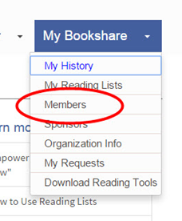
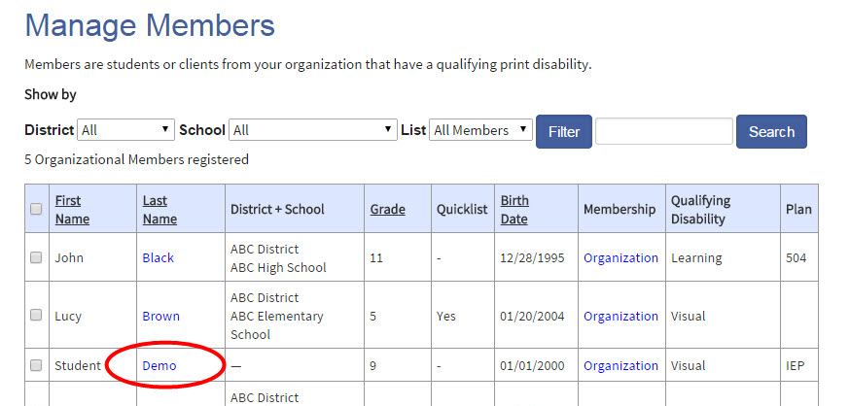
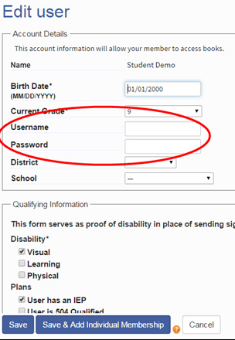
Limited Student Access
Giving students on Organizational Accounts access to Bookshare Web Reader and Read2Go is easy!
Note: Skip this step for students with Individual Memberships
Notes:
Set up your Student’s Login:
1) Log in to your account.
2) Go to “Members”
3) Select a student with an organizational membership and select their last name to edit.
4) Set a username and password for your student. Usernames can be an email, nickname, or student ID, and must be unique and a minimum of 6 characters long.
Tip: Write down the username and password on a useful form found in the “Help Center" under “Training and Resources > Brochures and How-To Guides.”

Slide 33
Roles in an Organizational Membership
Point of Contact
Sponsor (Educators)
Member (Students)
Responsibilities: organizational account oversight, communication with Bookshare, adding at least one Sponsor.
Responsibilities: Add and manage Members. Download books for members. Encourage individual memberships.
Responsibilities: Read Bookshare books using multiple methods.
Note: Sponsors and the Point of Contact can only be listed under one organizational account per email address

Slide 34
Considerations for Setting up an Organizational Account
Are there any active Bookshare accounts within our school or district already?
Should we set up the account at the district or school level?
Who will oversee and manage the account (point of contact)? How frequently do they review the membership list
Will we create any additional restrictions/regulations outside of those Bookshare mandates for use of account?
Do we need to use a confidentiality rider?
How will we share Bookshare with staff and families?

Slide 35
Sharing Bookshare with Families
Things to emphasize:
  The Bookshare basics (what it is, why their child is eligible)
  The benefits of Bookshare for their child
  Ease of signing up through school
  Free access while a student
  Something they can transition with through life
  Additional resources:
  Handouts and letters home to share with families

Slide 36
Value-Add Option for Members
Individual Membership
Benefits:
Students can take school work home and study
Install free reading tools on home computer
Download own books, including fun, leisure books
Build reading skills and independence year-round
Can easily transition to postsecondary education and adulthood
Easy to sign-up or connect an existing membership.
FREE for all students who qualify at school, sign them up today!
36
Notes:
These are some of the benefits of helping students access Bookshare at home – ready anytime anywhere! We’ll cover ‘how’ easy it is for a teacher to facilitate!
Before moving on, I’d like to point out that for those students who do not have access to the internet at home, they can still download books and reading tools to a CD, thumb drive, other accessories that they CAN take home.
36

Slide 37
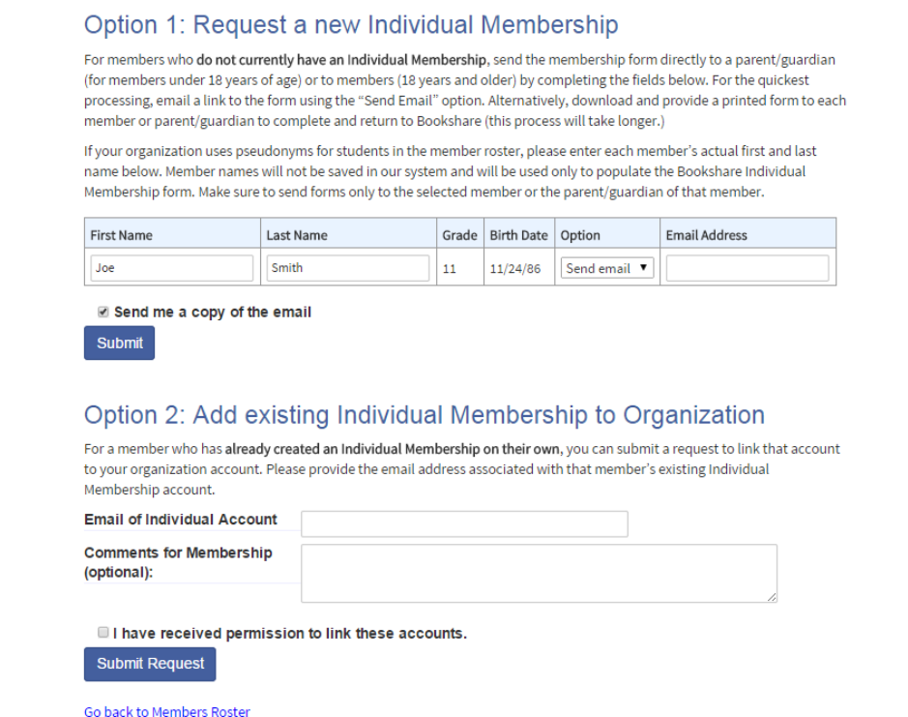

Encouraging Individual Memberships
Teachers Can Make the Process Easy!
Option 1: Request New Individual Membership
  Student doesn’t already have membership
  Add student actual name if school uses pseudonyms
  Select e-mail (family’s e-mail address) or download form
  Proof of disability already on file
  Option 2: Add Existing Individual Membership
  Student already has individual membership
  Need to know associated email address
Notes:
You can help your students get Individual memberships with an easy process. Students who have individual memberships (with their own passwords) can download books for themselves.
Bookshare now allows all Individual Memberships, including members who are under 18 years of age, to agree to the Bookshare Terms of Use online. Members who are under 18 will require a Parent or Guardian to complete the online agreement form.
This form will automatically appear for all new members during the sign up process. For existing members who have not yet completed their agreement can log into your account, select the My Bookshare page, and select the Complete Agreement Online link from the account status banner. If you require a physical form please select the Request Help link below to request one from the Customer Service team.
If the student is already a member of your organizational membership, you can get them an Individual Membership without sending additional proof of disability. Go to My Organization, select the “Members” option, select a student on your roster and select the “Add Individual Membership” button. You’ll be asked to email or download a PDF form. This form contains a special code that will allow Bookshare to approve disability based on the student’s organizational membership details. Have the student or parent fill out the remaining fields online or on the form and obtain applicants digital signature.
Trainers should also make sure to remind teachers that they should inform students and parents of Bookshare rules and future trainings.
Teachers will have access to the “Bookshare letter for parents” on the Bookshare.org website in the ‘training page’ where they can also find the Bookshare quick guides.
Steps:
Easily Print Pre-filled Individual Membership Forms
Login to Bookshare
Select “My Organization” from task bar
Select “Members”
Select check box by name of each student
Email or download and print forms
Download and print “Send Home Membership Letter for Parents” on Bookshare Training page
Email or send home both forms with your students for parents to read and sign up online

Slide 38
Terms of Membership Agreement:
Books for readers with “Qualified” print disabilities only
Print disability, legal definition
Book file sharing not allowed
Consequences of copyright violation
Sponsors – No Login Sharing!
Notes:
38
This covers the main points regarding our usage terms for organizations.
Access to Bookshare books is a privilege, and it is based on a social bargain between the publishers and authors and the disability community.
It’s important to not redistribute these Accessible Media to other individuals, regardless of whether or not they would qualify for Bookshare. Members are permitted to use Bookshare books for their own personal use. Bookshare uses Digital Rights Management (DRM) technology and contractual agreements with Members to maximize personal access to books and minimize abuse of this privilege. Bookshare copyrighted books are not available to the general public, and cannot be shared with individuals other than the Member for whom the book was downloaded, regardless of whether or not the other individual would qualify for service.
Teachers should inform students about these restrictions and that these Accessible Media are for their sole use.

Slide 39
Seven Point Digital Rights Management
◆ Qualified Users
  Only qualified users with certification of disability on record.
❖ Contractual Agreement
  All users have to agree to terms of use that forbid violation of specific
  copyright laws.
⬥ Copyright Notice
  All books in our library contain a copyright notice.
 Encryption
  All books are encrypted for a specific user.
 Fingerprint
  All downloaded copyrighted material is fingerprinted as to allow
  us to trace files that show up elsewhere back to the Member.
 Security Database
  All transactions, encryption codes and fingerprints are stored in a
  database enabling Bookshare to track any unusual activity.
 Security Watch Program
  Monitors all book downloads and suspends any user whose account
  exhibits unusual activity.
Notes:
Qualified users: Only blind or other persons with disabilities that affect their ability to access print are permitted to download copyrighted books.
Contractual agreement: All Bookshare users have to agree to terms of use that forbid violation of the copyright law restrictions on redistribution and use of copyrighted material. Users who violate these terms will lose their access to Bookshare and may suffer other legal consequences as a result of their actions. Attorneys from the publishing industry had the opportunity to comment on these agreements and Bookshare made numerous changes in response to their concerns.
Copyright notice: In order to comply with the copyright law regulating the provision of accessible books to people with disabilities (17 U.S.C. § 121), Bookshare ensures that all copyrighted materials bear a notice that any further reproduction or distribution in a format other than a specialized format is an infringement. Such content includes a copyright notice identifying the copyright owner and the date of the original publication.
In addition, there is other language reminding users of their obligations to use this material only as permitted by their agreements with Bookshare and the law. It also informs people who are not Bookshare users that their possession of a Bookshare digital book is a violation of the copyright law and that they should erase such a book without using or copying it.
Encryption: Bookshare encrypts a requested book for a given user. The content delivered for that user can be decrypted only by a password and is then saved to the specified DAISY or BRF (Braille) file.
Fingerprint: All copyrighted material downloaded is fingerprinted as part of the encryption process so that the identity of the authorized user is contained within the decrypted material in a difficult to find fashion. This way, if a user illegally redistributes material downloaded from Bookshare, it is possible to confirm both that the materials came from Bookshare and which user was responsible.
Security database: All transactions, encryption codes and fingerprints are stored in a database enabling Bookshare to track any abuse to the source. Users are informed of the existence of this database as part of Bookshare's privacy program, and are informed of the limitations of the use of this data (it will only be used to respond to abuse problems, and not for marketing or other purposes).
Security watch program: A security program monitors all transactions and will suspend any user whose account exhibits any excessive downloading of content or other unusual activity. This program will build usage profiles and over time will be strengthened through experience to flag potential abuse. For example, there will be an active effort to suspend accounts that show evidence of abuse.

Slide 40
Questions?
Notes:
Q&A on morning topics
Check basic understanding of Bookshare
Check understanding of eligibility requirements
Check understanding of membership options
Following Q&A and before taking break, find out who has an account and who does not. Inform participants that for remainder of the day they will be working hands-on either within Bookshare

Slide 41
Bookshare Website

Slide 42
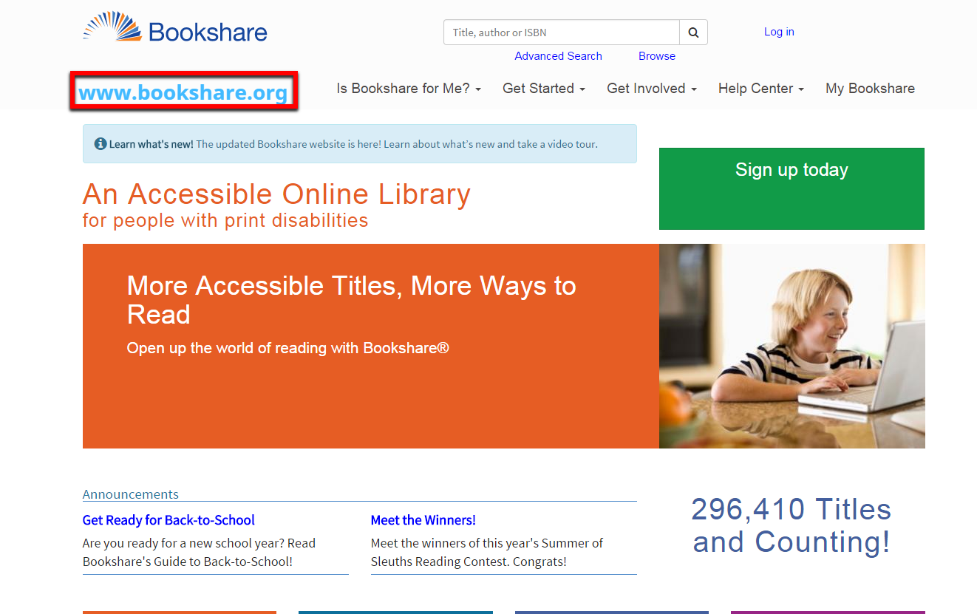
Bookshare Website

Slide 43
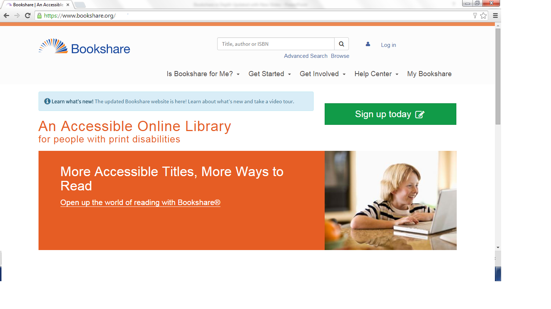
Home Screen
Important Tabs
Notes:
This is a screen shot of the bookshare website home screen with the Help Center, My Bookshare, and Get Started tabs highlighted as tabs that participants might be interested

Slide 44
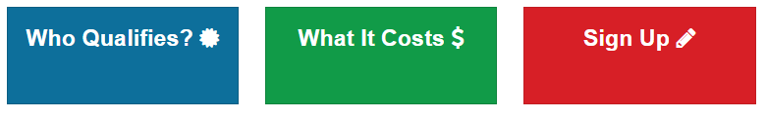
Is Bookshare for Me?
Learn more about Bookshare
Learn about who qualifies for Bookshare
Learn about membership options, costs, and international partners.
Sign-up for an individual membership or organizational membership account.

Slide 45
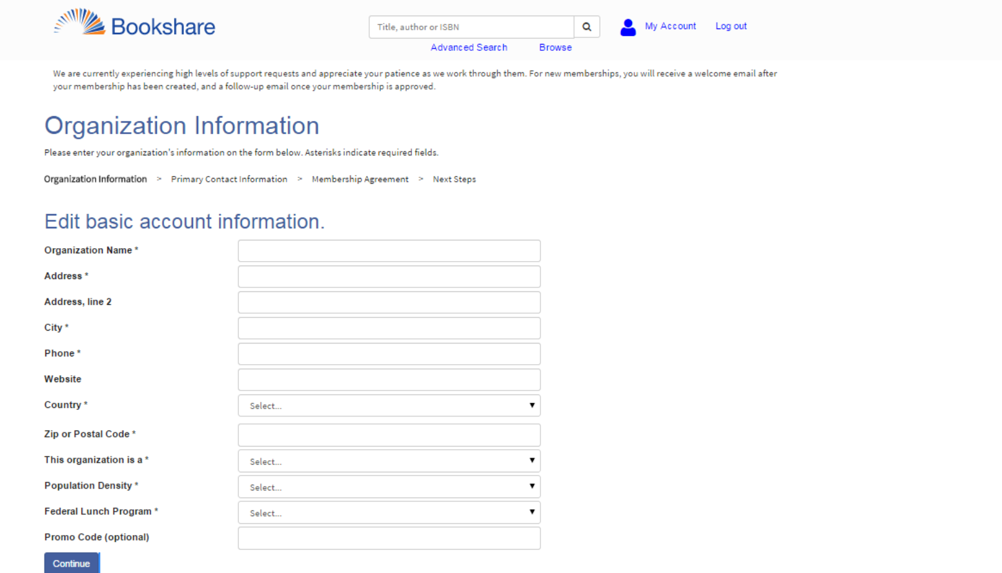
Signing Up for an Organizational Membership
https://www.bookshare.org/signUpOrganization

Slide 46
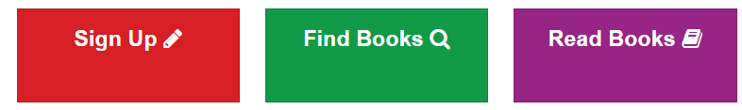
Get Started
Sign-up for an individual membership or organizational membership account.
Learn how to find and request books.
Learn how to read books on your own (individual members)
Learn how to help others read Bookshare books (organizational membership)
Find out about compatible reading tools (https://www.bookshare.org/cms/node/545)

Slide 47
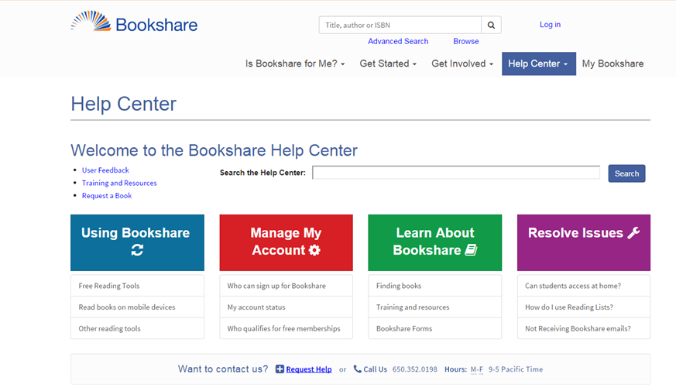
Help and FAQ’s https://www.bookshare.org/cms/help-center
Notes:
Useful section for finding answers to common tech and membership questions. You can also find contact information for our support team. You will also find quick links to User Feedback and Training and Resources. Make your book requests this way too.

Slide 48
The Help Center
Find answers to your questions.
Search by topic area.
Fill out request or call Bookshare with a question.
Request a book.
Find training and learning resources (Bookshare Academy)
Submit product feedback.

Slide 49
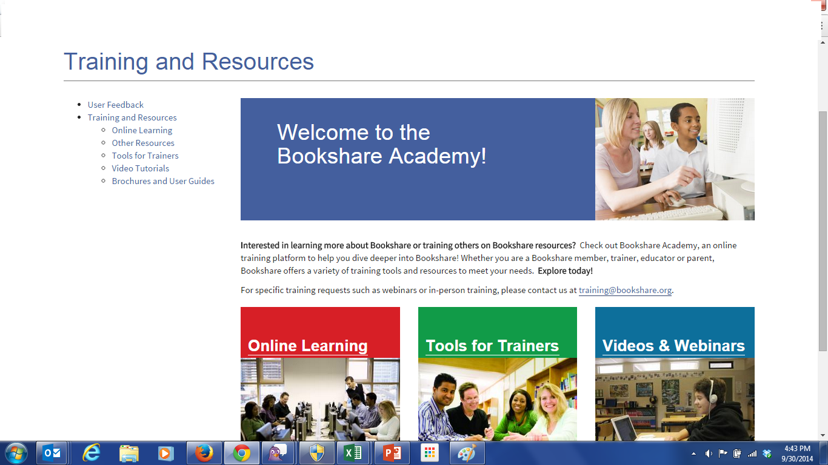
Training and Resources https://www.bookshare.org/cms/help-center/training-and-resources

Slide 50
Bookshare Academy: The New Home for Training Resources
Find online courses and partner resources
View videos and webinars
Access Tools for Trainers
  Field Trainer Resources
  Mentor Teacher Program Resources
  Parent Ambassador Program Resources
  Pre-Service Teacher Resources

Slide 51
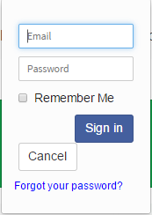
Log-In to Bookshare Website

Slide 52
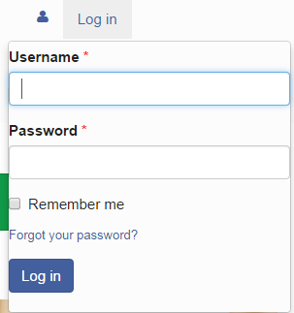
Can’t Find or Remember Your Password?
Welcome email contains link to set password
  Forget your password?
  Use link.
  Watch for second email with new reset link
  Check SPAM folder
  If emails blocked, contact us http://www.bookshare.org/contactUs
Don’t share log-in!

Slide 53
Using the Demo Account
  Log in - orgdemo@bookshare.org
  Password - demo480

Slide 54
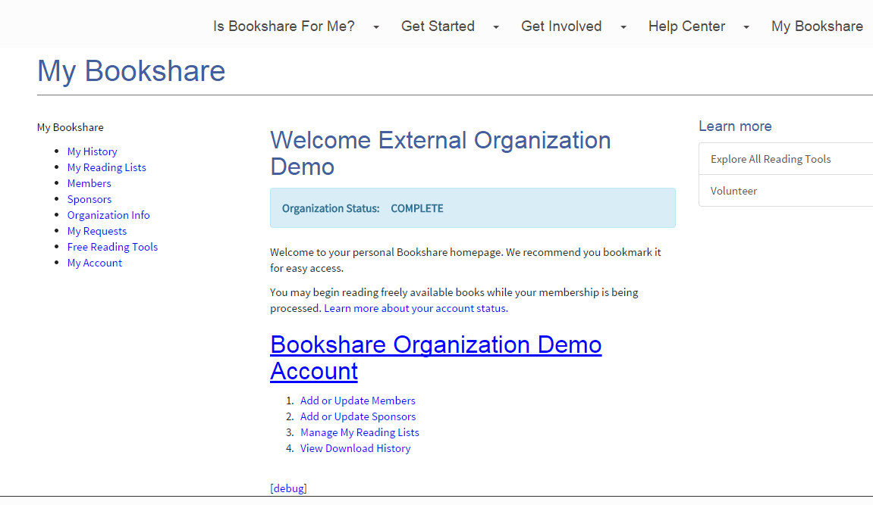
My Bookshare: Managing Your Bookshare Account
Notes:
This is your personalized home page, used to be called the Task Bar and it is now called My Bookshare. This is where you can manage your account, update your student and teacher roster, see your recent downloads, manage your reading lists, see your recent requests and access free reading tools.
54

Slide 55
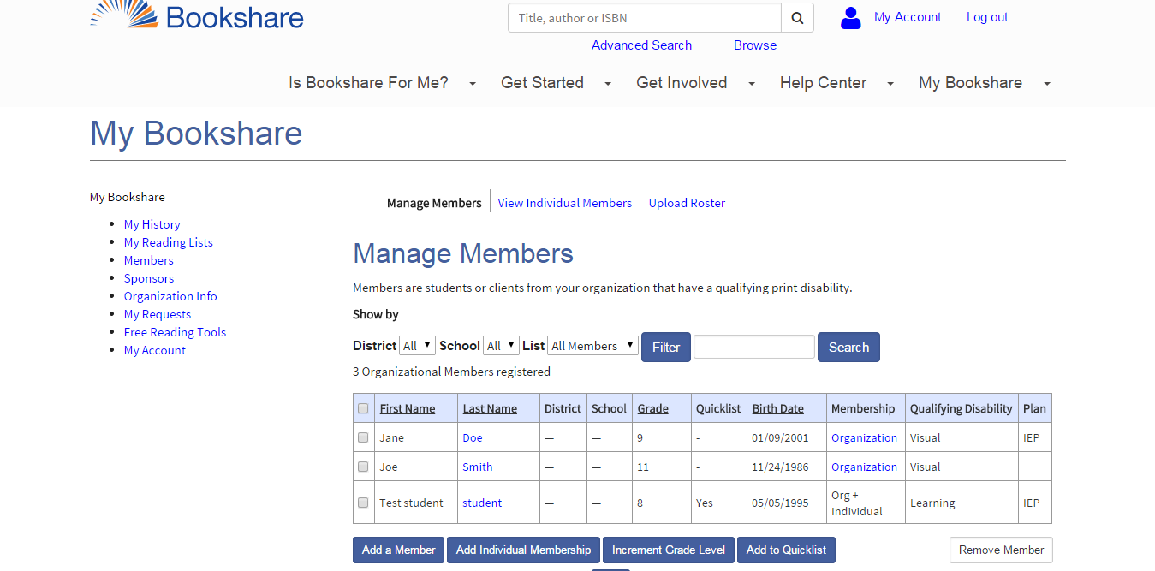
Member Roster
Note: This may look different if you are a private school or a educational organization. You may be required to submit documentation to Bookshare for students to be added to the account.
Notes:
This is a screen shot of the My Organization/Members tab. The demonstration will show how to add a member. Add a new student (if using the demo account, add a “fake” student name).
Sort by school, filter by quicklist.
55

Slide 56
Practice
View your account information and make any necessary updates
Add members to your organizational account
  If using the demo account use fake information
  If your students information is already in there confirm that it is correct
Add students you work with to your Quicklist
If Using Demo Account:
  Log in - orgdemo@bookshare.org
  Password - demo480
Notes:
Take 5-10 minutes to practice adding/checking members

Slide 57
Module 2:
How to find the books your students need?

Slide 58
What is available in the
Bookshare library?
Textbooks
  More than 5,000 NIMAC textbooks with images
  More than 8,000 non-NIMAC textbooks
  Contributions from universities and schools
Teacher-Recommended Reading
Special Collections
  New York Times Best Sellers
  Newbery Winners
  Caldecott Winners
  Young Reader’s Choice
  Spanish books
Newspapers and magazines
  Available through partnership with NFB Newsline
  270 national and regional newspapers and magazines
Bookshare
is committed to
high-quality books. Please report any quality issues on the book download page.
Notes:
58
BOOKSHARE OFFERS: Digital books for individuals with print disabilities
What does Bookshare’s library look like? As you can see, it’s pretty extensive. We have more than ### NIMAC textbooks, a collection of teacher-recommended reading, as you can see here, a significant list of Special Collections, and at least 270 national and regional newspapers and magazines.

Slide 59

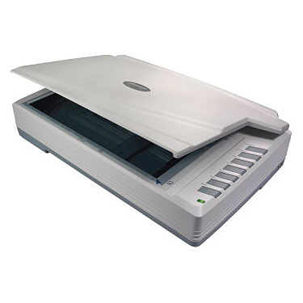






How Bookshare Gets Digital Books
Bookshare
Chop
Scan
Proofread
Volunteers
Universities
Publishers
Notes:
Bookshare believes that people with print disabilities should have the same ease of access to books and periodicals that people without disabilities enjoy.
Bookshare operates under an exception to U.S. copyright law which allows copyrighted digital books to be made available to people with qualifying disabilities.
The law states that it is not an infringement of copyright for an authorized entity (Bookshare is an authorized entity) to reproduce or to distribute copies of materials if they are reproduced or distributed in specialized formats exclusively for use by blind or other persons with disabilities.
The definition of “blind or other persons with disabilities” DOES NOT refer to the IDEA definitions, but rather the definitions within copyright law. So, just because a student has an IEP or 504 plan does not make them automatically eligible for Bookshare. In a little while, we will go over in more detail student eligibility requirements.
Bookshare is able to maintain such an extensive inventory of book for these reasons:
Bookshare: we receive &/or purchase hardcopy books regularly – and our dedicated volunteers help us chop, scan and proofread!
NIMAC textbooks are easily retrieved through Bookshare – we’ll talk more about NIMAC later….
Universities are a growing partnership for Bookshare, sending us academic to career planning books on a regular basis.
Publishers, as just covered, we’re enjoying the incredible partnerships we have with some of the top publishers in the industry, and this too, is a partnership that is and will continue to grow………

Slide 60
The NIMAC
Central repository to store digital textbooks from publishers: the National Instructional Materials Access Center (NIMAC) http://nimac.us
Established under IDEA 2004 at the American Printing House for the Blind, Inc. (APH) with support from the U.S. Department of Education
Only U.S. K-12 students with an IEP and a print disability are eligible for using NIMAC books in Bookshare
Only educators can download NIMAC books for these students
Notes:
Let’s talk a little more about one of these sources – NIMAC. (Possible discussion question for participants: Are you familiar with NIMAC?)
“NIMAC-sourced books” are digital books produced from publisher files deposited in the National Instructional Materials Accessibility Center (NIMAC), a national repository.
http://nimac.us
-Requires states to address the need for accessible textbooks for students with print disabilities
-File format: National Instructional Materials Accessibility Standard (NIMAS)
-Established at the American Printing House for the Blind, Inc. (APH) with support from the U.S. Department of Education
Bookshare converts these books from the NIMAS format (National Instructional Materials Accessibility Standard) to student-ready DAISY and BRF formats before placing them in the Bookshare library.
Accessing these books is different than other Bookshare media because of the terms of the Individuals with Disabilities Education Act (IDEA 2004) that established the NIMAC. As a result, these books are subject to the terms of the NIMAC’s Limitation of Use Agreement. There are two key points to remember about accessing Bookshare’s NIMAC-sourced books:
They are only available for U.S. K-12 students with print disabilities as defined in the Chafee Amendment to copyright law, AND who have an Individualized Education Plan (IEP).
Only teachers and staff members of U.S. K-12 education agencies can download these books. To ensure that Bookshare complies with the above limitations, students, parents, transcribers, private school teachers and adults with print disabilities cannot download these books.

Slide 61
Books available through NIMAC but not in Bookshare
When a book is available in the NIMAC but not yet in Bookshare, the process to get the book through Bookshare depends on whether or not your state has named Bookshare an Authorized User of NIMAC.
  If Bookshare is an Authorized User in your state, Bookshare can secure the book for you once a Book Submission Request is provided to include: ISBN, title, and author
  If Bookshare is not an Authorized User in your state, you will need to go to your state’s NIMAC Coordinator to assign the book to Bookshare.
  Send request or, physical copy to Bookshare (can take up to 3 months)
Notes:
Send a conversion request or a physical copy of the book to Bookshare. You should know however, that:
We cannot accommodate math and science textbooks with a lot of images, graphics, equations, etc. due to scanning technology not able to recognize.
The physical book will be unusable after it is chopped and scanned.
The process to add a physical book to the collection can take up to 3 months.

Slide 62
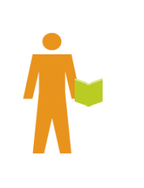
Bookshare as a State
Authorized User
Search Bookshare’s Web site for textbook
If book is not found in Bookshare, search the NIMAC
If book is in the NIMAC, use Contact Us to request the book. Provide ISBN number, title and author
Bookshare gets book ready for student and sends email
Sponsor downloads book for qualified student
    Average turn-around: 7-10 business days
Get Book
Search
Request
Bookshare
Sponsor
Sponsor
Notes:
Use this slide and the next one if the state has designated Bookshare as a NIMAC Authorized User (AU). Each state is permitted to name up to 5 Authorized Users for the state.
Image shows the flow from a sponsor to Bookshare to the sponsor when Bookshare is an Authorized User.

Slide 63
NIMAC Resources
http://nimac.us = find NIMAC books & information
http://aim.cast.org/learn/policy/state/nimas_nimac_contacts#.UkyODz8iyPg = locate your state-coordinator
http://aim.cast.org/learn/policy/local = find sample publisher contract language
Notes:
By agreeing to deliver the materials marked with "NIMAS" on this contract or purchase order, the publisher agrees to prepare and submit, on or before ___/___/_____, a NIMAS fileset to the NIMAC that complies with the terms and procedures set forth by the NIMAC. Should the vendor be a distributor of the materials and not the publisher, the distributor agrees to immediately notify the publisher of its obligation to submit NIMAS filesets of purchased products to the NIMAC. Files will be used for the production of alternate formats as permitted under the law for students with print disabilities.
This is page __ of __ of this contract or purchase order.

Slide 64
Bookshare Use by Type of Book
Bookshare Downloads | Who Can Download | Student Qualifications
Public Domain and freely distributable books | Non-Members and Members | None
Books with U.S. copyrights Books with International permissions | Sponsors and Members | Chafee Qualified
NIMAC-sourced books | Educators (K-12 U.S. public schools, some private schools and agencies) | Chafee + IEP
Bookshare is authorized to produce digital books in accessible formats through an exemption in the U.S. copyright law called the Chafee Amendment.
Notes:
64
The copyright exemption (“Chafee Amendment”) exists to help the small number of people whose disabilities have a major impact on their ability to read.
The Chafee Amendment allows authorized entities, such as Bookshare, to create specialized formats of copyrighted printed works.
Under law, only students with qualifying print disabilities (i.e., qualify under the Chafee Amendment) and have IEPs (i.e., need specially-designed instruction) are eligible to receive textbooks from the NIMAC. Students with 504 Accommodation Plans – even if they qualify under the Chafee Amendment – are not eligible to receive NIMAC books in specialized formats.
There is a different eligibility requirement for Bookshare than IDEA.

Slide 65
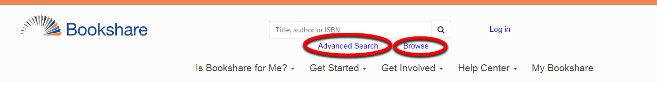
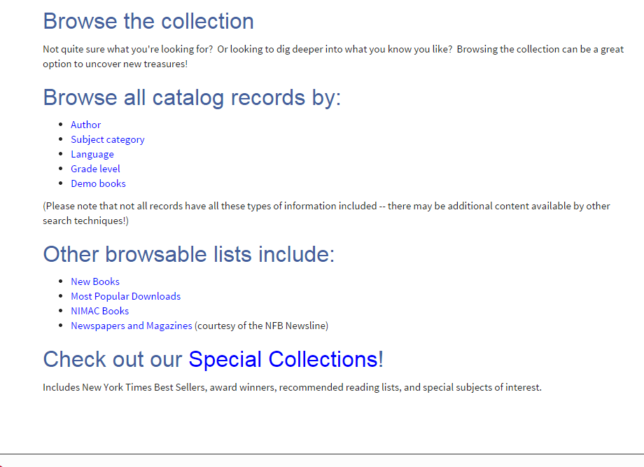
Search or Browse
Standard Search
by
Title or Author
Browse by….
Author
Category
Language
New Books
Most Popular Downloads
NIMAC Books
Special Collections
Newspapers / Magazines
Internationally Available
Grade
Publisher
Notes:
Standard search by title or author.
Example of a Standard Search:
Search all text, including the title, author and contents of every book in the library, quickly and efficiently. A search for “William Shakespeare,” for instance, will return all books with William Shakespeare in the title or in the text of the book — as well as Shakespeare’s works.
(Type William Shakespeare in the search box. The search results will return any book that has “William” AND “Shakespeare” anywhere in the book.)
BROWSE: Search using “Browse” to view the extensive inventory by….
Authors
Categories
New books
Most popular downloads
NIMAC books
Special collections
Newspapers and magazines
Internationally available titles

Slide 66
Louis Plus
The Louis Plus search in the Louis Database locates accessible instructional materials in Louis, NIMAC, and Bookshare - http://louis.aph.org/custom/SearchResults_UnifiedSearch.aspx
The Louis Database has information on over 405,000 accessible print materials including braille, large print, sound recording ,and electronic files from more than 160 organizations.

Slide 67
Practice
Explore our collections
  What did you find?
  Did you notice you can do related searches or report a book quality issue?
If Using Demo Account:
  Log in - orgdemo@bookshare.org Password - demo480
  Go to Browse & select Demo books
  Within Advanced search select Freely Available Books from Books to Search
Notes:
Take 5-10 minutes to practice searching for books

Slide 68
Reading Lists
Similar to physical bookshelves: compile book titles in one location, stay organized!
Organize and classify books (by grade level, subject matter, etc)
Track books you might want to download at a later date
Can be private or shared with members

Slide 69
Reading Lists: Sharing with Members
Educators can create reading lists and easily share with students so they can read or download books on their own – including NIMAC books!
  NIMAC textbooks are available to K-12 students who qualify for Bookshare and have IEPs
    Create a "syllabus" to assign to one or more of your members allowing students
    Students can read books on reading lists anywhere they have internet access
    Track student activity on assigned books
Notes:
With Reading Lists you can create virtual bookshelves that help you stay organized and save books that you can download anytime, anywhere you have Internet… OR you can share with students so they can download and read on their own… even NIMAC textbooks!
Stay organized by keeping all of your books in the Reading Lists. No more having to manage multiple files for multiple students on multiple school computers, all the books live in your Reading Lists on the Bookshare website.
Encourage your students to read over the summer by creating personalized Reading List for each student for assigned summer reading.

Slide 70
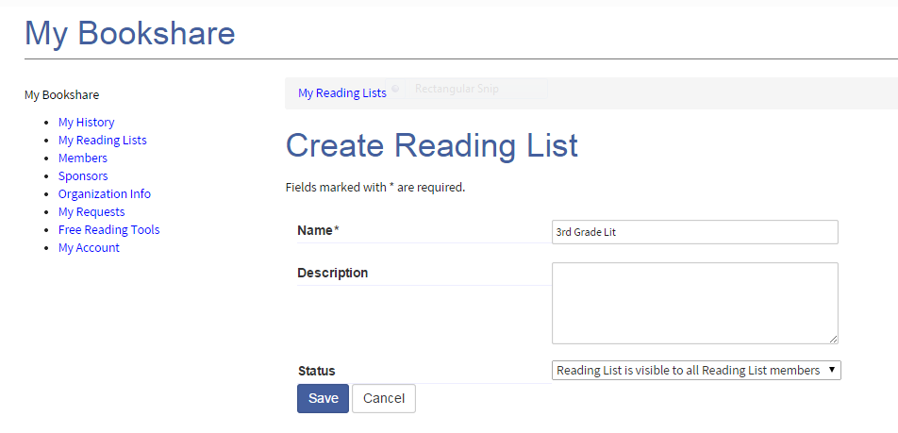
Creating a Reading List
To share with students - select “ Reading List is visible to all Reading List Members” from dropdown menu

Slide 71
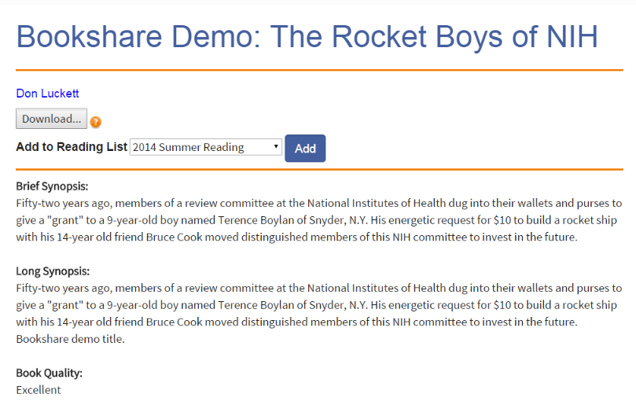
Adding a Book to Your Reading List
Select the appropriate Reading List from the dropdown list.

Slide 72
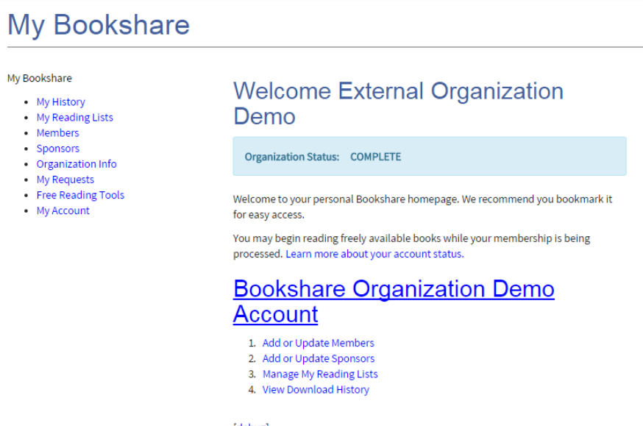
Accessing Your Reading Lists
Click on My Reading Lists to view your lists

Slide 73
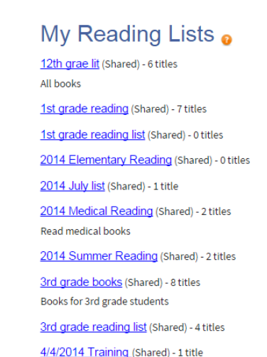

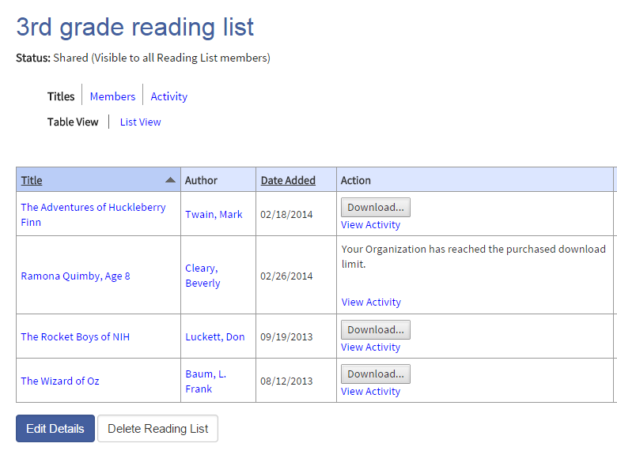
View Reading Lists

Slide 74
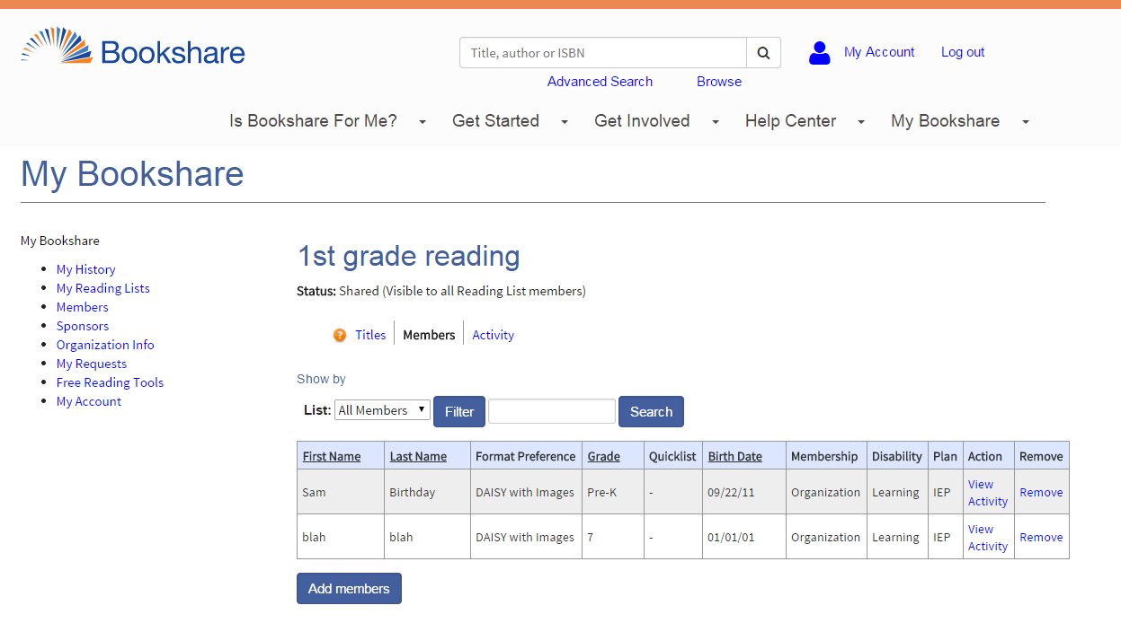
Add Students to Reading Lists
Select “Add Members”

Slide 75
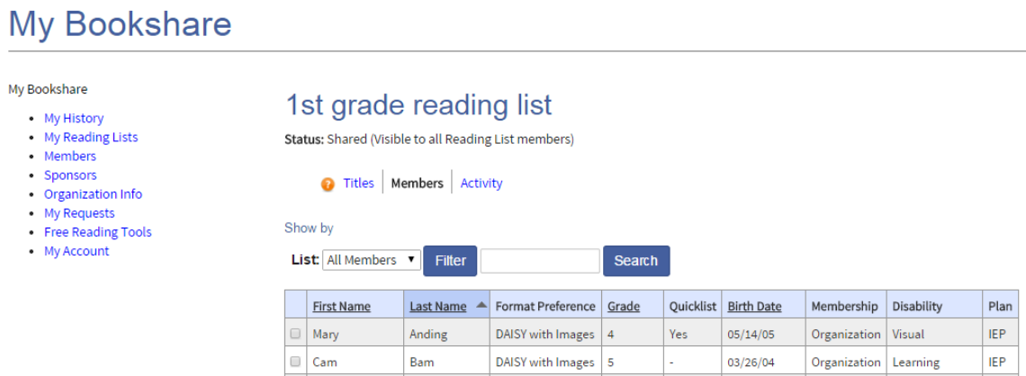
Sharing Reading List with a Student
Select the student(s) you want to share with.

Slide 76
Practice
Set up a Reading List for your students
If Using Demo Account:
  Log in - orgdemo@bookshare.org Password - demo480
  Go to Browse & select Demo books
  Within Advance search select Freely Available Books from Books to Search
Notes:
Take 5-10 minutes to practice setting up bookshelves

Slide 77
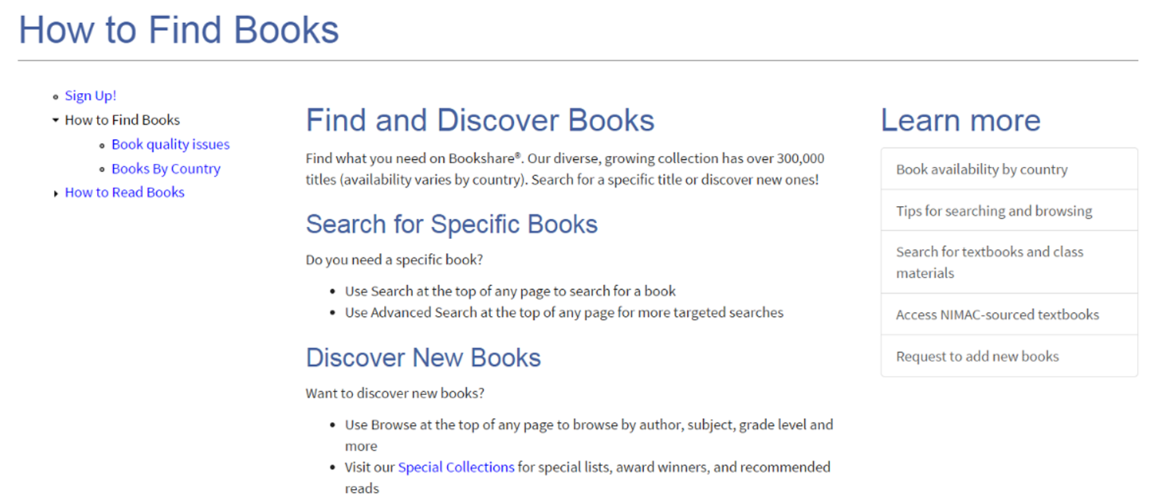
Requesting a Book
Under the “Get Started” Tab
  Select “How to Find Books”
  Select “request to add new books”
  Fill out request form
Notes:
Other sources if you can’t find your book include:
http://www.nimac.us/
https://www.learningally.org/
http://www.accesstext.org/ (for post-secondary)

Slide 78
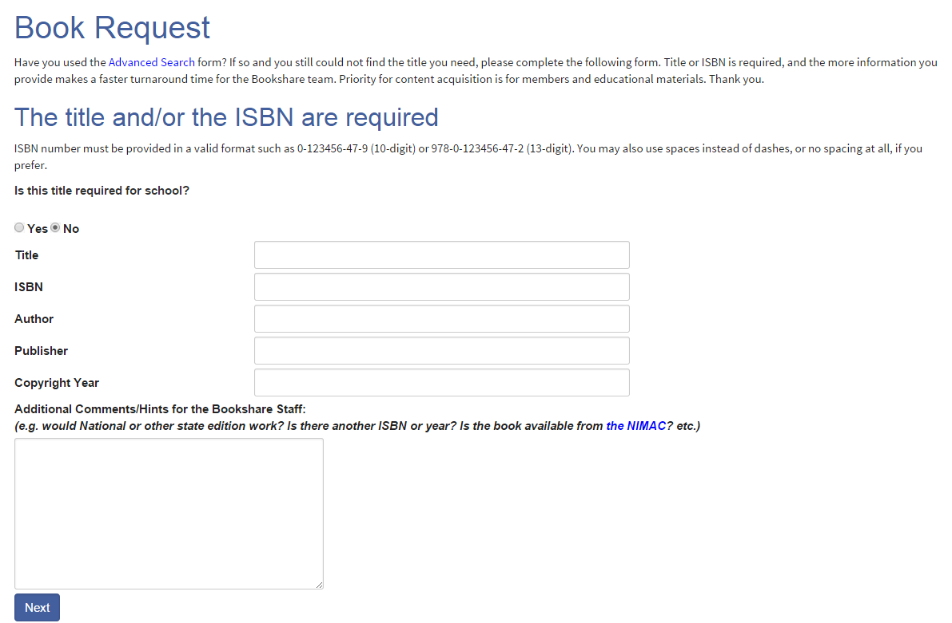
Book Request Form

Slide 79
Module 3:
How to find the right tools for your students?

Slide 80
Reading Technology Partners
Kurzweil - www.cambiumlearningtechnologies.com
TextHelp Read&Write Gold - www.texthelp.com
HumanWare – www.humanware.com
HIMS BookSense - www.hims-inc.com
APH Book Port DT - www.aph.org
Freedom Scientific - www.freedomscientific.com
Dolphin – www.yourdolphin.com
Dynavox - www.dynavoxtech.com
Voice Dream - www.voicedream.com
AccessText Network - www.accesstext.org
Notes:
All of these partners are connected with our API with the exception of Dynavox. This means if you use the software or hardware you will be able to download directly from Bookshare from within the software/hardware. No extracting files or setting up separate book folders. I list Dynavox because our collection is compatible and many of our members use the device.
The Hims models include their newest, the U2 and its predecessor the Braille Sense Plus. They also sell a smaller model called the OnHand. (not too sure about the uppercase H). All feature a Bookshare app that can download and unzip our DAISY text and BRF books.
HumanWare manufactures the Braille Note Apex. Its predecessor is the Braille Note mPower. These note takers do not feature a Bookshare app but can download our books with some difficulty.
Freedom Scientific sells the PAC mate. It doesn’t feature a Bookshare app but our books can be downloaded and unzipped, again with some difficulty.
The American Printing House sells the Braille Plus 18, 2nd gen. which features a Bookshare app.
These same companies also sell stand-alone braille displays. Older models connected through a serial or a USB port. Current models offer Bluetooth connectivity.
Freedom Scientific sells the Focus Blue.
Hims sells the Braille Edge.
HumanWare sells the Brailliant and BrailleConnect.
These displays can either connect to a computer to support a screen reader or connect to IOS or Android devices.
American Printing House
http://www.aph.org
Freedom Scientific
http://www.freedomscientific.com
Hims-Inc
http://www.hims-inc.com
HumanWare
http://www.humanware.com

Slide 81
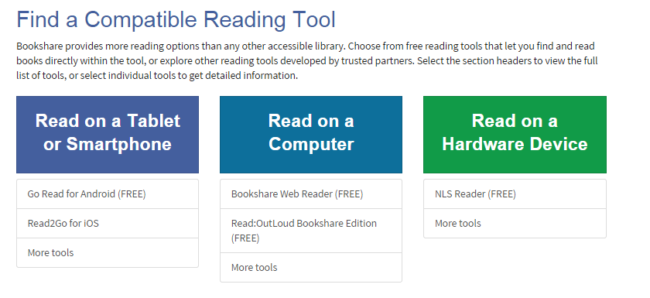
Bookshare Reading Options
Notes:
We also offer several ways to access Bookshare books…
The key is figuring out what technology works best for your student and equipping them with the tools they need to be successful.

Slide 82
Read on The Computer

Slide 83
Ways to Read on the Computer
Web Reader
Software on Computer
Available freely from Bookshare
Read directly on web browser (no software required)
Compatible with chromebooks and other notebooks
Numerous compatible software programs available
Download and read books from Bookshare website through the software programs
Some are freely available

Slide 84

Web Reader: Reading Bookshare Books on the Web
Members can read books in their Internet browser!
No downloading necessary
  No need to use specialized reading tools
Takes advantage of Google Chrome and Safari accessibility features – text to speech and word highlighting
  TTS is in whatever voice is installed on computer
  Can also use Internet Explorer and Firefox (need screen reader, no word highlighting)
Notes:
Lets go back to our student. The teacher set up the Reading List and now the student wants to read her assignment. Now they can log onto Bookshare.org click the Reading List and read the book directly in a browser with Bookshare Web Reader.
Get your students user names and passwords and/or Individual Memberships so they can use Web Reader at school, home, or anywhere with Internet and a support Internet browser.
If you have had problems using reading applications you need to install on your computer, or downloading files, or finding and opening book files, try Bookshare Web Reader.
If students are at a computer, like a library or relatives house that doesn’t have a specialized reading tool, they can use Bookshare Web Reader to read assigned books.

Slide 85
Browser Information Bookshare Web Reader
Fully supported browsers with built in text-to-speech (TTS) and word-level highlighting:
  Google Chrome version 33+
    Google Chrome versions 14-32 with Bookshare Chrome Extension installation
  Safari version 6.1+
  Chromebooks version 14+ with Bookshare Chrome Extension installation
Supported browsers for displaying books and reading with screen readers:
  Mozilla Firefox version 17
  Internet Explorer version 9
Compatible with Chromebooks
Note that mobile browsers such as Safari for the Apple iPad, iPhone, or iPod Touch are not currently compatible.
Notes:
Text-to-Speech (TTS) Voices:
The following voices can be used with the text-to-speech (TTS) and word-level highlighting option using Google Chrome:
Windows XP: Microsoft Mike or Mary
Windows Vista or 7: Microsoft Anna
Mac: Alex

Slide 86
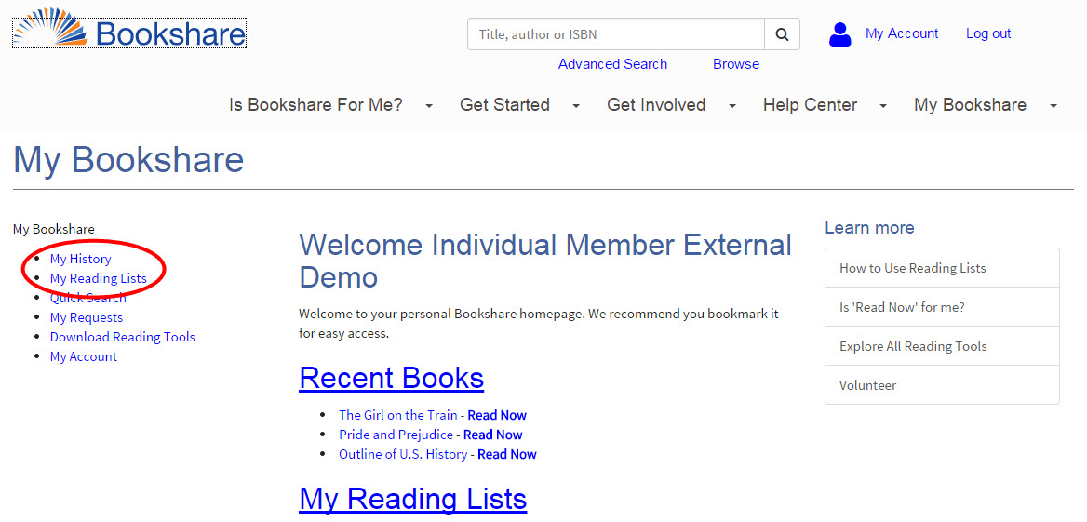
Bookshare Web Reader
Students Access Books from a shared Reading List or My History
Notes:
Add books to reading lists and share with student(s).
For students with Limited Access accoungs:
1. Log out and let your student log into Bookshare.
2. Student Select a book from a Reading List (or recent books from My History).
3. Select “Read Now.”

Slide 87
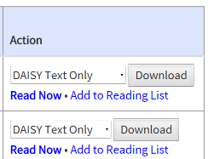
Reading in Bookshare Web Reader
Just find a book and select “Read Now”

Slide 88
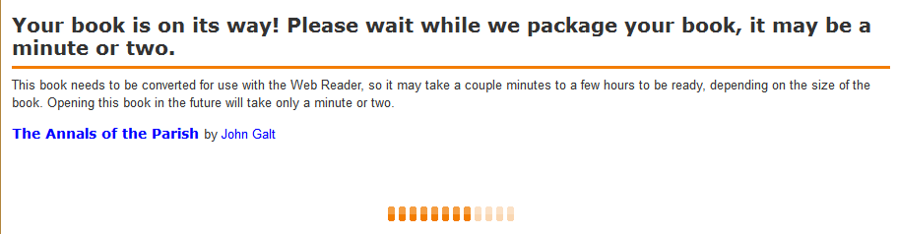
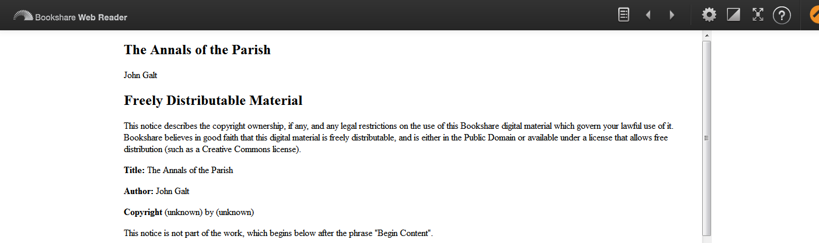
Opening the Book Directly in Bookshare
It may take a couple minutes but the book will automatically open in your browser

Slide 89

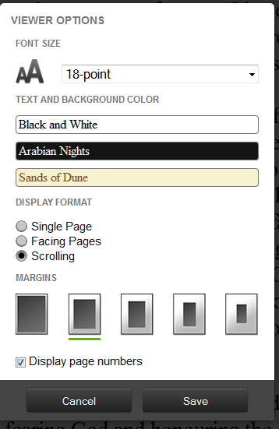
Navigating in the Book
Move page/section forward or backward
Change text/background color
Additional information
Table of Contents
Change settings including the font size, the text and background color, the display format, and the margins

Slide 90
Practice Downloading Books
Using Web Reader
  Using Organizational Demo Account:
  Sponsor:
    Log in - orgdemo@bookshare.org
    Password - demo480
  Student:
    Log in – StudentDemo
    Password- Bookshare
  Using Individual Demo Account
  Log In - individualdemo@bookshare.org
  Password – memberdemo
    Go to Browse
    Select Demo books

Slide 91
Compatible AT Software: Reading Bookshare Books on the Computer
Any AT software supporting text-based files
  HumanWare Victor Reader Soft
  Don Johnston READ:OutLoud
  Windows
  choose to install the free Acapela synthetic voices
  Kurzweil 3000, 1000
  TextHelp Read & Write Gold
  Freedom Scientific WYNN
  Freedom Scientific OpenBook
  Gh Player
  Dolphin EasyReader
  DAISY Consortium AMIS
  Nextup TextAloud
  Innovative Rehabilitation Technology eClipseReader
DAISY software players - http://www.daisy.org/tools/
  Free versions available for Members!
  Free for members
  high-quality
  Acapela voices
  See https://www.bookshare.org/cms/help-center/other-reading-tools#applications
Notes:
91
To read accessible books from the Bookshare® library, you will need some kind of access technology, such as a hardware device or software reading tool; in addition you can read books in your web browser. If you do not already have software for reading DAISY books, you can download one of the free versions available with your Bookshare membership on the Reading Tools page. The free software that comes with Bookshare membership can be installed on all computers a Member uses to read the books, including a personal computer at home. Both of these tools are DAISY readers.
This list of software DAISY readers is not all inclusive. (http://www.daisy.org/tools/ - DAISY Consortium website)
Victor Reader Soft Bookshare Edition. This new and improved version is much easier to use and has more functionality than the previous version. It is designed for people who are blind or have low vision. Use this software if you are a screen reader user and want a fuller-featured DAISY reader.
READ:OutLoud Bookshare Edition. This DAISY reader is designed specifically for people with learning disabilities. It is not recommended for use with screen readers. This software features high-quality text-to-speech for multi-modal reading, spotlighting, note-taking and other study skill features, an online dictionary, and more.
Bookshare offers free Acapella TTS voices for download, which provide better quality male and female synthetic voices (Ryan and Heather). The file is large (200MB) and takes time to download.

Slide 92
Download Free Bookshare Software
Victor Reader Soft
  Only compatible for PC
  Future versions of the software are no longer being developed
  Designed for people who are blind or have low vision
Read:OutLoud
  Compatible with PCs and MacOS 10.4 - 10.8
  Designed for people with learning disability
  Acapela Voices
  Better quality voices
  Available for Mac and PC
Notes:
If you do not already have software for reading DAISY books, you can download one of the free versions available with your Bookshare membership on the Reading Tools page. The free software that comes with Bookshare membership can be installed on all computers a Member uses to read the books, including a personal computer at home. Both of these tools are DAISY readers.
Victor Reader Soft Bookshare Edition. This new and improved version is much easier to use and has more functionality than the previous version. It is designed for people who are blind or have low vision. Use this software if you are a screen reader user and want a fuller-featured DAISY reader. Victor Reader Soft version 2.6. is designed for people who are blind or have low vision. This is a self-voicing, full-featured DAISY reader that reads only Bookshare books. Please note that future versions of this software will no longer be developed; however, you can continue to use it and get support from Bookshare.
READ:OutLoud Bookshare Edition. This DAISY reader is designed specifically for people with learning disabilities. It is not recommended for use with screen readers. This software features high-quality text-to-speech for multi-modal reading, spotlighting, note-taking and other study skill features, an online dictionary, and more. Read:Outloud 6 Version 2.1 with support for Lion on Macintosh computers is now available. We highly recommend all Members upgrade to this version for better performance with large books.
This DAISY reader is designed for people with learning disabilities and allows you to read multi-modally, take notes, look up definitions and more. It is not recommended for use with screen readers and can read only Bookshare books.
Bookshare offers free Acapella TTS voices for download, which provide better quality male and female synthetic voices (Ryan and Heather). The file is large (200MB) and takes time to download.

Slide 93
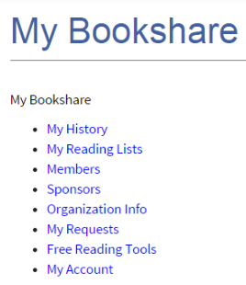
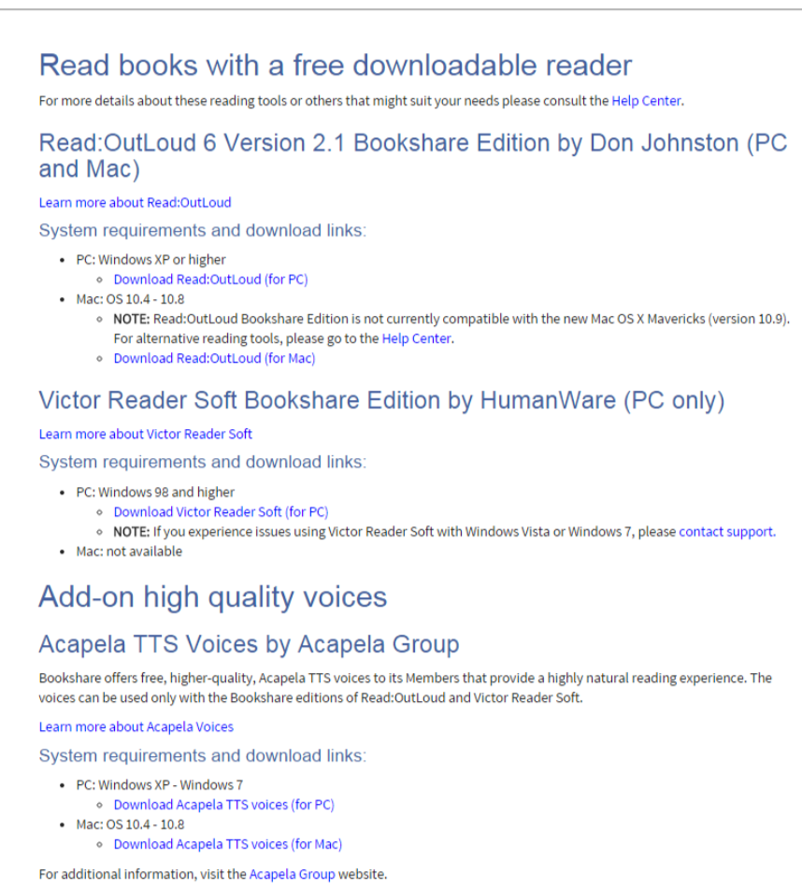
Downloading Free Software
*Remember: You must be logged in to download programs
Notes:
Free with Bookshare membership. You should already have the software on your computer for today, but you can download the software by going to the bookshare website, getting started, reading tools. For Macs you will download Read Out Loud, Acapela Voices, and an extraction software such as Stuffit or Unarchiver.

Slide 94
Downloading Books to Your Computer
Go to www.bookshare.org and log in with your account
Search/Browse for book
Select Download (Note: you receive 100 downloads each month. If you need more, contact Bookshare)
Select students (members)
Confirm download
Click Available/Downloaded under Status within My History
Save the zip file
Find saved zip file (it may automatically download to the My Downloads folder on your computer)
Extract or unzip zip file (may vary slightly based on software) but try to unzip into a file folder to ensure all the parts of the book are saved together
Notes:
94
These are the high-level steps you’d take to download a book from Bookshare’s extensive library. Now, lets take a closer look at each of these steps.
If you want to distribute the same book to multiple students, you’ll need to download a separate copy of the book for each student. During the downloading process, you’ll have the option to select multiple Member names. At the finish page, you will see a separate book file for each Member you selected, marked with that Member’s first and last name. Select each file to begin the download process. Ultimately, downloading files one by one will be faster for you, because file size would increase if multiple student books were in one zipped download. Also, you can distribute the smaller zipped files individually to each student. Please be sure each file goes to the right student, in keeping within Bookshare's digital rights management policy.
Bookshare books can be copied to other media (e.g., CD, flash drive, school district network drive – password protected on school networks) for the purposes of transferring the book to the qualified Member selected when the book is downloaded. While the media containing the books may change, books must stay in the possession of the qualified Member.
Bookshare books cannot be handed over to someone other than the student for whom it was downloaded. Following is an excerpt from the Organizational Agreement that covers this concept:
Each time I download a book from Bookshare, I will select the Member for whom I am downloading the Accessible Media. I will decrypt the Accessible Media using my password and deliver it only to the Member for whom I downloaded that particular Accessible Media. I agree that once I have delivered the book to that Member, I will delete the copy I downloaded.
Saving Books with Internet Explorer
Internet Explorer asks you for a location each time you download a file, so you can choose where you want to store your books. Bookshare recommends that you create a folder just for books and always save books to that folder.
Saving Books with Mozilla Firefox
With Firefox the default location for downloaded files depends on the operating system:
Windows XP saves downloaded files to the Desktop.
Windows Vista saves downloaded files in a Downloads folder in your user folder (e.g. Joe Smith > Downloads).
To change the download settings in Firefox, go to the Tools menu and choose Options. You can specify a different download location or you can have Firefox ask you for a location each time you download a file.
Saving books with Safari on a Macintosh
Safari saves downloaded files to the Downloads folder in your user folder. Once you download a Bookshare “.zip” book file, you will then need to open and save the file using Unarchiver or Stuffit so you can read the book using your Safari browser.
When you install Unarchiver or Stuffit, you are asked where you want to save “unzipped” files.
Use a common list of novels to search during this lab. (Have participants notice the differences between download procedures for copyrighted vs. out of copyright books.)

Slide 95
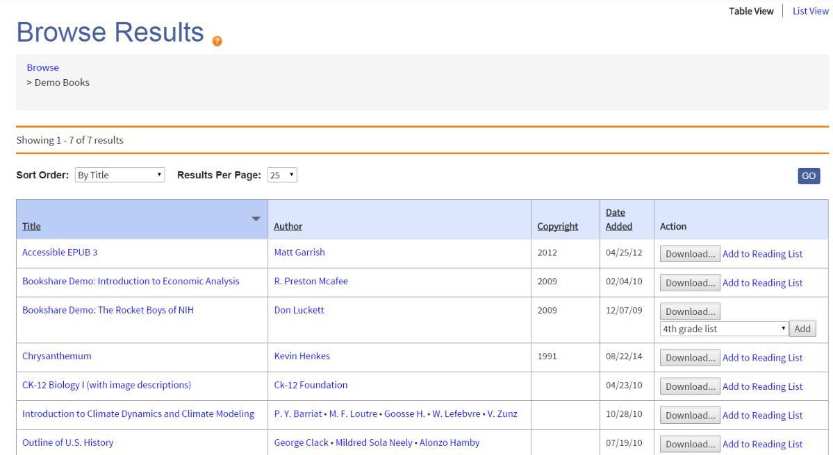
Downloading a Book
Download book or add to a Reading List

Slide 96
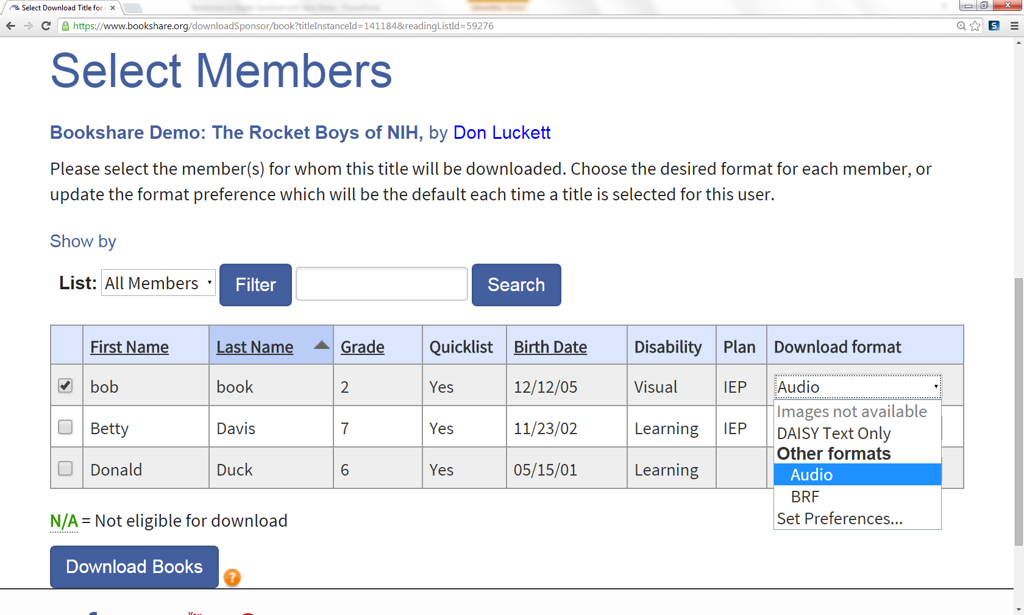
Select a Member and Format Type
Notes:
Next you will select which member should receive the downloaded book. You can select more than one, but will receive a different book to download for each student. You will also select what format the book will be. Remember the Format options are DAISY, Audio, BRF

Slide 97
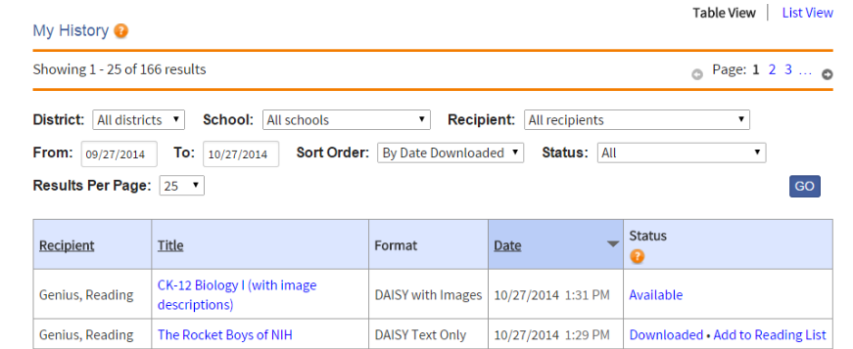
Downloading Book
Select Available and save book to a flash drive or network folder
Notes:
You will confirm the download and then be taken to your my history page. Look at the Status. If the book is available you can click on the link to be taken to the zip file. If the book has images or is not yet available it will be noted and you will receive an email when it is available. Clicking on the link you will receive the book in a zip file.
http://www.dummies.com/how-to/content/how-to-change-safaris-default-file-download-locati.html
If you’ve visited a Web site that offers files for downloading, typically you just click the Download button or file link, and Safari takes care of the rest. The Downloads status window keeps you updated about the progress of the transfer. While the file is downloading, you can continue browsing or even download additional files; the status window helps you keep track of what’s going on and when everything will be finished transferring. To display the Download status window from the keyboard, press Command+Option+L.
By default, Safari saves any downloaded files to the Downloads folder that appears in your Dock. To specify the location where downloaded files are stored — for example, if you’d like to scan them automatically with an antivirus program — follow these steps:
1 Choose Safari→Preferences.
Alternatively, press Command+, (comma). The Safari Preferences dialog opens.
2 Click the General tab; then click the Save Downloaded Files To pop-up menu and choose Other.
A file navigation dialog will open.
3 Navigate to and select the location where you want the files stored and click Select.
The new location will appear in Save Downloaded Files To section.
4 Click the Close button to exit Preferences.
The folder you chose will now be the default location for anything you download from the Internet.
You can choose to automatically open files that Safari considers safe — things like movies, text files, and PDF files that are very unlikely to store a virus or a damaging macro. By default, the Open “Safe” Files after Downloading check box is selected on the General pane. However, if you’re interested in preventing anything you download from running until you’ve manually checked it with your antivirus application, you can deselect the check box and breathe easy.
Safari has matured to the point that it can seamlessly handle virtually any multimedia file type that it encounters. However, if you’ve downloaded a multimedia file and Safari doesn’t seem to be able to play or display it, try loading the file within QuickTime Player — the Swiss Army knife of multimedia players that can recognize a huge number of audio, video, and image formats.

Slide 98
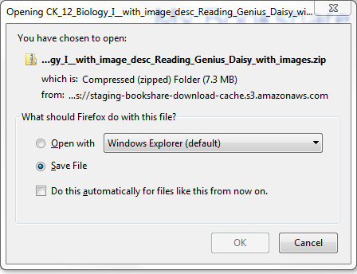

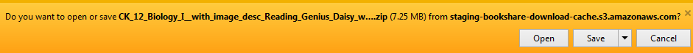
Book File Download

Slide 99
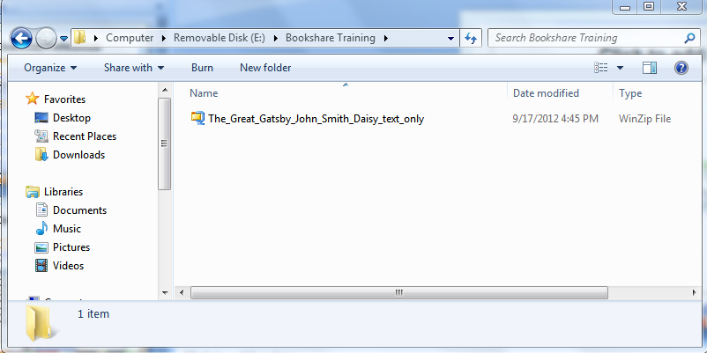
Save to Flash Drive/Network Folder/ or Other Location

Slide 100
Extract File
In order to open a book in the software program you must extract it (should not say zip or compressed file anymore)
For a PC:
  Right click when book is highlighted and click on extract all, or
  Click into file folder and press extract all on the top bar
  May look different based on your extraction software
  You can close the folder once you have extracted (don’t worry about all the components of the folder but do not delete

Slide 101
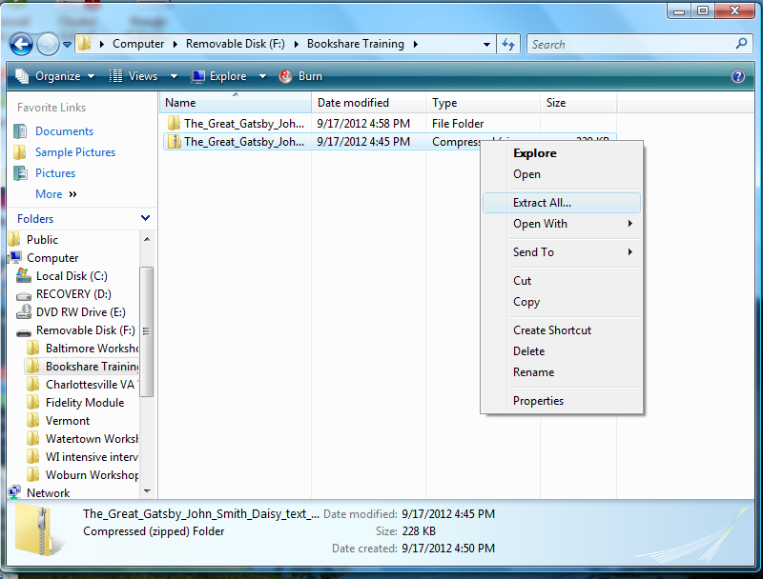
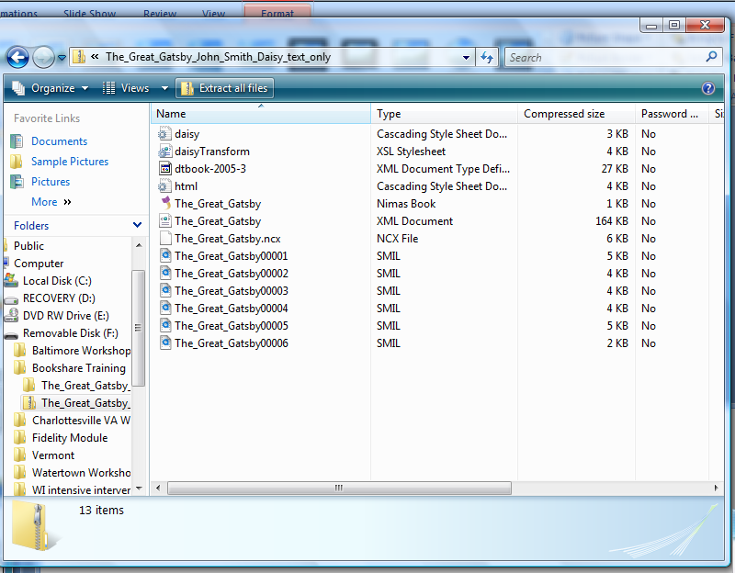
Extracting Files
Notes:
Right click and click extract all
or
Double click into zipped folder and click extract all

Slide 102

Folder Should Look Like
Unzipped file that we can use with software programs
Zipped file

Slide 103
Example - Folder Set-up
How you set up your folders is up to you, but it is essential that you keep the entire zipped book folder together in order for the book to work
Bookshare
Grade Level
Student A
Student B
Science
Math
Social Studies
English
Science
Math
Social Studies
English
Notes:
This is an example of a organizational hierarchy for storing and accessing Bookshare books on a school network or other media. Every school is different, participants should understand and follow the system suggested at their school, typically established by the IT person. This is an EXAMPLE and the point is that it’s important to know/follow a system of storing to ensure ‘ease’ of access. It is very important to keep the book together in one place (reason for all the folders, but the level of folders may not be necessary).

Slide 104
Practice Searching for and Downloading Books
Set up a folder system
Search for books
Set student preferences
Download books
If Using Demo Account:
  Log in - orgdemo@bookshare.org Password - demo480
  Go to Browse & select Demo books
  Within Advance search select Freely Available Books from Books to Search

Slide 105

Using Read:OutLoud (ROL)
Speak and highlight
Change the voices
Bookmark text
Click on words to find definition
Take notes, annotate, create an outline and bibliography, and more
Browse the web
Notes:
ROL allows us to
View text that is spoke and highlighted
Change the voices
Can bookmark text
Can click on words to find definition
Take notes, annotate, create an outline and bibliography, and more
Browse the web

Slide 106

Read:OutLoud Bookshare Edition
Notes:
Any book you download through this method will be useful only in the ROL software (not in VRS).

Slide 107


Opening a Book From Your Computer in ROL
Go to the e+ in the upper left-hand corner or “File”, then “Open”.
Go to the location where you saved your book on your computer.
Click on the file folder of the book you want to open. You should see just one option to click on (if there are images you might also see a folder with those)
Double click on the file (.opf)

Slide 108

Opened Book in ROL

Slide 109


Navigating ROL
To Increase the size of the toolbar go to view and small/large toolbar
Highlight text-you can use yellow and red highlighters to create an outline
Change layout of pane (all book, half book/half notes, all notes, ect.)
Import e-text (books you have downloaded)
Increase/decrease size of text
Dictionary
Jump to start of book
Play
Add a note
Bibliographer tool

Slide 110

Read, Highlight, Take Notes
Highlight text, create an outline, take notes, create a bookmark
Increase the font size for students who are visually impaired

Slide 111
Practice Using the Software to Read Books
Use Read:OutLoud to open books
Search for a book through Read:OutLoud
Read and follow along
Bookmark and take notes
Save and reopen file
If Using Demo Account:
  Log in - orgdemo@bookshare.org Password - demo480
  Go to Browse & select Demo books
  Within Advance search select Freely Available Books from Books to Search
Notes:
20 minutes

Slide 112


Bookshare XML file Format
When using Bookshare files with a screen reader you may want to open the XML file format.
When you download a DAISY file type, you will also see that there is an XML file in the folder (XML Document)
Double click on the XML Document file type and it will open in an internet browser
Your browser will use a CSS style sheet to make the text look nice. Similar to the old HTML extension files.
If your application or device doesn’t work with XML files, rename the XML file to an HTML extension instead of the XML extension
Note: If you don’t see your file extensions listed go to Organize->Folder and Search Options->View and uncheck Hide extensions of known file types and press Apply

Slide 113
Read On Hardware Devices

Slide 114


Compatible AT Hardware
Any AT hardware supporting DAISY text and MP3 files
  HumanWare VictorReader Stream
  and ClassMate Reader
  Plextalk Pocket
  BookCourier and BookPort
  Braille displays like the HumanWare BrailleNote,
  Freedom Scientific PAC Mate, and GW Micro Braille Sense
  LevelStar ICON™
  Intel Reader
  DAISY player or MP3 player for Symbian and Windows phones
See: https://www.bookshare.org/cms/help-center/other-reading-tools#hardware
Notes:
114
Bookshare books work on hardware players that include synthetic speech features and/or MP3 players. Portable braille and audio-based notetakers often include DAISY-related features and functionality, as well as MP3 players.
Also, any commercial MP3 player will play Bookshare MP3 files.
This list does not include all the hardware players that play Bookshare formats.

Slide 115

Bookshare with a Braille Device
http://www.youtube.com/watch?v=SuT7cBaOKIY&feature=relmfu
Notes:
http://www.youtube.com/watch?v=SuT7cBaOKIY&feature=relmfu

Slide 116
Read On a Tablet or Smartphone

Slide 117


Bookshare On the Go!
Read2Go runs on iPod Touch, iPhone and iPad devices running iOS 4.0 or later. Purchase as App at Apple store ($20 and discounts for bulk education purchases)
Darwin Reader is available for download directly from Google play for $14.95 (free 30 day trial available). Designed specifically for blind, low vision, and print disabled users.
Go Read free reader for the Android OS optimized for Visually Impaired users called Go Read. This app is available for download directly from Google play.
Voice Dream runs on iPod Touch, iPhone and iPad devices running iOS 6.0 and later. Purchase as App at Apple store ($9.99, free trial version available)
Notes:
Students with Limited Access accounts can independently log in to Read2Go with their username and password.
Please Note:
Currently there is no Reading List function in Read2Go so student will need to search for specific titles that the Sponsor has shared with them via a Reading List or they have previously downloaded.

Slide 118



Read2Go: Search and Download
Connects directly to

Slide 119



Open Books from Bookshelf, Read
Notes:
Screen shot of opening book from a bookshare on the ipad app

Slide 120

Visual Settings for Different Disabilities
Severe learning disability such as dyslexia
  Word-by-word highlighting on
  Audio on
Good reader with a physical disability
  Highlight colors match background

Slide 121

Visual Settings for Different Disabilities
Readers with low vision
  Set font size up to 70 pts
  Set background and text colors for optimal reading
  Optional audio, on or off
Notes:
Shows how to increase the font size.

Slide 122

Audio Settings for Different Disabilities
Blind readers
  Voice Over navigation and gestures
  Audio on
  Choice of voice and rate
Notes:
Shows how to turn the audio on and adjust the speed.

Slide 123

DAISY* Navigation within Books
Up to 6 levels of navigation, depending on structure built into book
Bookmarks
Page level navigation
*Digital Accessible Information SYstem

Slide 124
Synching DAISY Books to iPad to get Books with Images
Ensure Read2Go is updated to version 1.0.3.10
Ensure images are turned on
Go to Bookshare.org in Safari
Search and download book
Use “Open In” function and select Read2Go
Notes:
From the Support Portal:
Ensure Read2Go is updated to version 1.0.3.10
Enable images are under the visual options
After images are enabled, search for a book with images from within Read2Go. When you select the book for download, you will receive a new pop-up message indicating the book is being prepared and that an email will be sent when the book is ready. When you receive this email, please open the browser, go to www.bookshare.org, and follow these steps:
Enter your login information
Click the “My History” link from your task bar
Press and hold on the “Available” link
Select “Open” from the menu
Select Read2Go from the “Open In” menu

Slide 125

Voice Dream
Free trial version. Full version $9.99
Integrated with Bookshare
Access to other web content
Reads PDF files, plain text, MS Word, MS PowerPoint, Apple Pages, RTF and HTML files and more

Slide 126

Voice Dream
Synchronized word and line highlighting plus options to disable
Includes bookmarking, definitions, highlighting, full-text search

Slide 127

Voice Dream
Change the word highlighting color
Customizable font (includes OpenDyslexia font), font size, and colors

Slide 128

Voice Dream Audio
Multiple voices and can buy additional
Change speech rate

Slide 129


Go Read
Android Application
Free for use
Download books from Bookshare Website
Zoom in/out, change text color
Navigate through table of contents, by page number
Multi-modal
  Does not highlight by word, but by sentence
Notes:
Android Application
Free for use
Download books from Bookshare Website
Zoom in/out, change text color
Navigate through table of contents, by page number
Multi-modal
Does not highlight by word, but by sentence

Slide 130

Darwin Reader
Compatible with Android devices and potential to be compatible with Kindle Fire
Can purchase directly from the Android Market Place and the Amazon Market Place.
Cost $14.95
Allows you to connect to Bookshare library to download books
Option to use Eye Free Mode (just sound) or Graphical Mode (includes text)
Notes:
http://www.amazon.com/New-Designs-Unlimited-LLC-Darwin/dp/B0079MIFI6/ref=sr_1_1?s=mobile-apps&ie=UTF8&qid=1349118461&sr=1-1&keywords=darwin+reader+for+kindle+fire
Darwin Reader is the first accessible Android book reader designed specifically for blind, low vision, and print disabled users. The app fully supports DAISY formatted audio and text books, and directly integrates with Benetech Bookshare and Librivox to make downloading books amazingly simple.
Read books using your preferred interface. For blind and low vision users, the app is completely navigable with the arrow keys. All menus are fully vocalized. Users with dyslexia and other print disabilities can quickly navigate by tapping the stylized graphics on the screen.
During playback, choose between two modes of operation. In the "Eyes-Free" mode, simply swipe your finger across the screen to easily move between sentences and sections. In the graphical mode, all menus are vocalized and include large, graphical elements.

Slide 131



Sign in and Select Book for Student
Select a student from your member list
Sign in with Bookshare account information
Search for a book

Slide 132



Choose Book and Reading Mode
Select the Reading Mode you want to use
Download the book and it will appear in the Darwin Reader Library
In Graphic Mode you will be able to read along with the highlighted text

Slide 133
Kindle/Nook/E-Readers
To comply with copyright law, Bookshare books must be provided in a specialized format (DAISY, BRF, MP3)
If you use a device, such as a Kindle or Nook, that requires books to be in ASCII text format, you can convert either the Grade 2 Contracted Braille files (BRF format) or the DAISY files into plain text. See handout “Mobile Reading Instructions” to See 2 Options for converting Books
You can change the format for your own use, but Bookshare’s fingerprinting and watermarking technology remain in place even if a file is converted to plain text. STILL NO SHARING

Slide 134

Downloading MP3s
For ITunes
Download MP3 audio file and extract compressed folder
Plug in the device (e.g., iPhone, iPod, iPad).
Open iTunes on your computer.
Create a folder in iTunes under Playlists (e.g., Bookshare MP3s).
Drag folder from your computer to itunes
Step by Step instructions available in Handouts

Slide 135
Practice
Practice using tablet or smartphone, computer, or hardware device.

Slide 136
Questions?
Notes:
Q&A on morning topics
Check understanding of how to search library
Check understanding of how to download books
Check understanding of how to use Read Out Loud and Victor Readers software
Following Q&A and before taking break, find out who has an account and who does not. Inform participants that for remainder of the day they will be working hands-on either within Bookshare

Slide 137
Training Evaluation
Under Help Center, Click on Training and Resources.
Click on Tools for Trainers
Click on “Bookshare in Depth Professional Development Workshop Evaluation” link
http://www.surveygizmo.com/s3/1252734/PDW-Follow-up-Survey-June-2013

Slide 138
Module 4:
How to support students transitioning to other schools or college and career?

Slide 139



Bookshare Spans a Lifetime
Students Transitions Adulthood
Notes:
Remember, Bookshare can follow a student through all transitions in life…

Slide 140
Student Transitioning to
New School or District
Put Bookshare in their backpack & keep student status current
Make sure new school has student on their Bookshare roster
Determine the best tools for your student for smooth transition
Inform parents on how to use Bookshare
Request books now!
Notes:
Any student transitioning here are some key tips. Get them an IM, make sure it follows them throughout their transitions. As long as they are a student it is free through OSEP support.
Maintain your roster, be sure new school has a membership and adds student
To maintain free membership, an annual renewal email will go out. Update Student Status with new school name
Keep parents informed
Make annual book requests (process is going to become easier very soon!) For now go to Contact Us and use requesting school book.

Slide 141
College Bound?
“If I am continuing on with postsecondary education, how do I maintain my Bookshare membership?”
  Use the summer months to prepare for your new school.
  You will want to have an Individual Membership:
    You can sign yourself up (students under 18 need a parent or guardian’s permission) or your school can help you get an Individual membership.
    Your new college or vocational school might have an organizational membership; you can also be added to that.
  Keep student status current with school information
Notes:
Keep your IM as you transition
Make sure you keep your student status current
Check to see if your new college has an org membership?
Start this summer learning about the services available to you! As a college student you are now your advocate. Not your IEP team!

Slide 142
Taking a Break?
If a student is not continuing on for post-secondary education, they can still maintain Bookshare membership.
  Student has 6 weeks to access Bookshare.
  Student should notify Bookshare membership
    Contact us at: www.bookshare.org/contactUs
      (select “Membership and Registration”)
    $75 Qualified non-Student - first year
    Breakdown: $25 one time set up fee for qualified non student +$50 yearly membership (students need not pay the $25)
    Once a student again, membership is FREE!
Notes:
Taking a break? 6 weeks to continue free access, after that it is $50/year with a one time $25 registration fee the first year.
If enroll in school again, a free membership can be accessed. Just contact us at membership@bookshare.org

Slide 143
Reading Success in College
Explore our Student Resources collection:
  https://www.bookshare.org/browse/collection/38/Student
  Not all DSS offices are the same. Learn more from the AHEAD site:
  http://www.ahead.org/students-parents
Understand what services are available and look for other programs like TRIO
Notes:
Tips from college students we know…
Test taking guides, life in college, etc.
Learn about DSS offices services ahead of time….
Look for other things like TRIO – federally funded program for students who are the first in family to attend college.

Slide 144
Reading Success in College
Try different AT – find what works
Advocate and take full advantage of services available
Communicate your needs from the start, get to know your professors
Be sure to have your Bookshare membership and make book requests in advance
Notes:
Learn what AT is available to you and what works best for you. Master the technology before you arrive at school. You’ll have enough to deal with with the new demands of college, etc. Arrive equipped to go!
Explore services available, take full advantage
Know your rights and communicate your needs from the get go. Get to know your professors. One student I know wrote a letter to each of her professors and before each semester, introducing herself, talking about her learning challenges and what kinds of things she does to keep up with school work

Slide 145
Next Steps

Slide 146
Personal Journaling
Review what you had noted during the personal journaling time at the beginning of the session.
  Were your questions answered?
  Did the training meet your objective or goals?
  Discuss with partner/team

Slide 147
Action Plan
Think about how you might implement Bookshare in your classroom or with students
Use the Action Plan Template to frame your conversations
Be prepared to share out with the group
Notes:
This can also be delivered as an THINK-PAIR-SHARE to identify next steps. (This may work better if you don’t have participants from same district or schools).
Reference handouts – sample and blank action plan template
Here’s an EXAMPLE of an action plan and how you might consider implementing Bookshare into your classroom. Here you’ll TRAINER to point out various populated fields and prepare participants to discuss and begin populating their own classroom action plans. Depending on time and class size, trainer may consider breaking the group into 3-small groups for a hands-on approach and then to allow each small group to ‘share’ with everyone.
Participant from group: get them to openly share ways on how you’d apply what you’ve learned today, into your classroom:
What are some simple steps you can take next-week?
How would you begin to complete this form? By-student, By-class,
Let participants view the POPULATED template = here’s an EXAMPLE of a CLASSROOM action plan…..call-out some things….let them view this….THEN, click to next slide = BLANK TEMPLATE to solicit ideas on how they’d populate this. Each participant received an e-file of this template (sent to the primarily contact setting up this workshop), they can access and use once back in school.
ENCOURAGE DIALOGUE AND GROUP SHARING/LEARNING!

Slide 148
Become a Mentor Teacher
Access Training Materials
Network with over 500 other educators
Share best practices
Learn about special promotions
Receive a chance to win technology for your school
Find more information: https://www.bookshare.org/cms/get-involved/connect/mentor-teachers-program

Slide 149
Become a Parent Ambassador
Connect with other parents of Bookshare members
Be the first to know about and try new Bookshare tools
Get access to Bookshare training materials and brochures for parents
Meet with other parents in your area
Enter to win technology prizes
Find more information: https://www.bookshare.org/cms/get-involved/connect/parent-ambassador-program

Slide 150




Connect with Bookshare
Visit - https://www.bookshare.org/cms/get-involved
Sign-up for our Newsletter (My Bookshare → My Account → Preferences)
Read our blog
Follow us on social media:
http://www.facebook.com/bookshare
Stay
Contected!
http://twitter.com/bookshare
https://www.youtube.com/user/BookshareTeam
https://www.pinterest.com/bookshare/

Slide 151
Bookshare Follow-up Support
The Help Center - https://www.bookshare.org/cms/help-center
Bookshare Academy - https://www.bookshare.org/cms/help-center/training-and-resources
  Learn it Now Videos
  Live and archived webinars
  Online courses for credit
Training requests and support -training@bookshare.org
Notes:
Show website again…..key e-mails: support@bookshare.org; membership@bookshare.org

Slide 152
Contact Bookshare!
Tech Support: Support@bookshare.org
Membership: Membership@bookshare.org
Training: Training@bookshare.org
Notes:
152
TRAINER: remove the education manager name that does not apply, keeping only the one that does.
Alabama Lisa Wadors
Alaska Christine Jones
Arizona Lisa Wadors
Arkansas Lisa Wadors
California Kristina Cohen
Colorado Kristina Cohen
Connecticut Christine Jones
Delaware Lisa Wadors
District of Columbia Christine Jones
Florida Lisa Wadors
Georgia Christine Jones
Hawaii Lisa Wadors
Idaho Lisa Wadors
Illinois Kristina Cohen
Indiana Kristina Cohen
Iowa Kristina Cohen
Kansas Kristina Cohen
Kentucky Christine Jones
Louisiana Christine Jones
Maine Christine Jones
Maryland Christine Jones
Massachusetts Kristina Cohen
Michigan Kristina Cohen
Minnesota Lisa Wadors
Mississippi Lisa Wadors
Missouri Kristina Cohen
Montana Lisa Wadors
Nebraska Christine Jones
Nevada Lisa Wadors
New Hampshire Kristina Cohen
New Jersey Christine Jones
New Mexico Christine Jones
New York Kristina Cohen
North Carolina Lisa Wadors
North Dakota Christine Jones
Ohio Lisa Wadors
Oklahoma Christine Jones
Oregon Kristina Cohen
Pennsylvania Christine Jones
Rhode Island Lisa Wadors
South Carolina Lisa Wadors
South Dakota Christine Jones
Tennessee Lisa Wadors
Texas Christine Jones
Utah Lisa Wadors
Vermont Kristina Cohen
Virginia Kristina Cohen
Washington Kristina Cohen
West Virginia Lisa Wadors
Wisconsin Kristina Cohen
Wyoming Kristina Cohen

Slide 153
Questions
Notes:
Final questions

Slide 154

Thank you.

